Slide 1
Click, Click, Metacognition!
How to Use Reading Apprenticeship in the Online Classroom
Zoe Fisher
Reference & Instruction Librarian
March 12, 2016
#metacon
@zoh_zoh
about.me/zoefisher

Slide 2
Today’s Outcomes
By the end of this session, you will be able to...
Use RA routines in your online classes
Develop online discussion forums that promote metacognitive conversations
Get to know your colleagues & hear their ideas for using RA in online learning

Slide 3
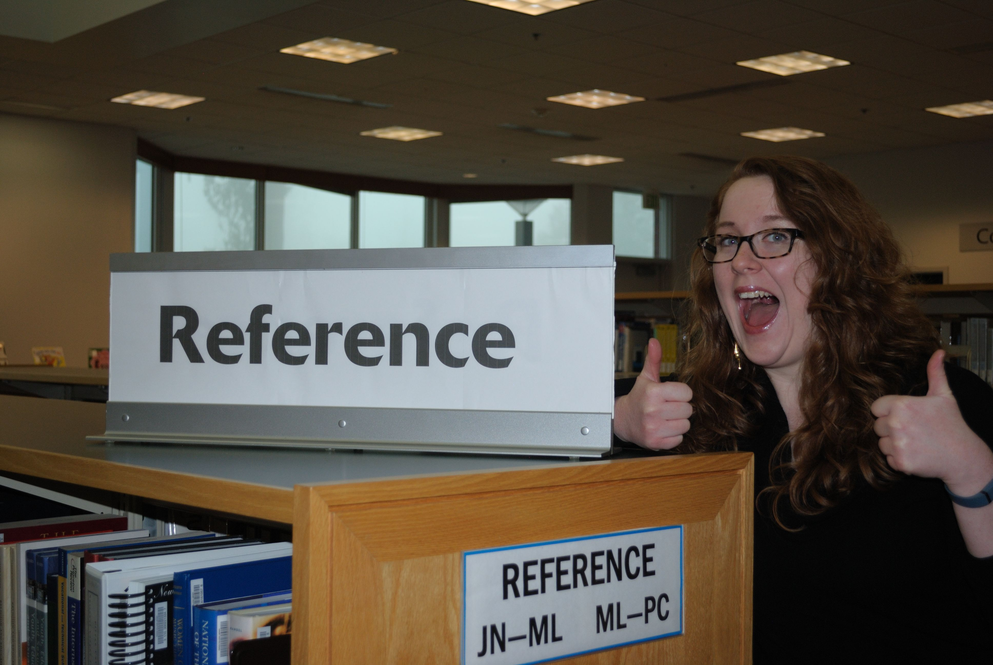
A bit about me…
Notes:
I’m a Reference & Instruction Librarian at Pierce College in Puyallup, Washington.

Slide 4
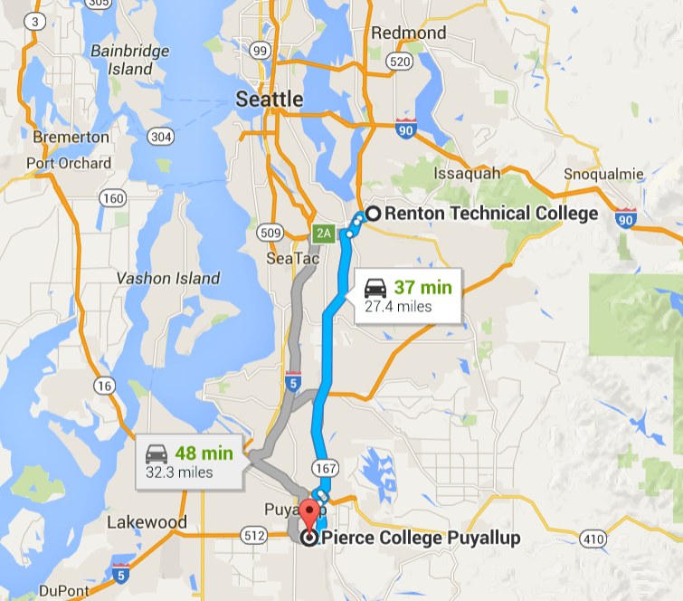
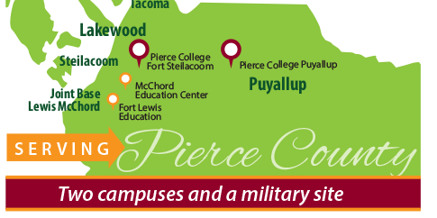
Pierce College has approximately 17,000 students and 9,000 FTE at two campuses and our military site.

Slide 5
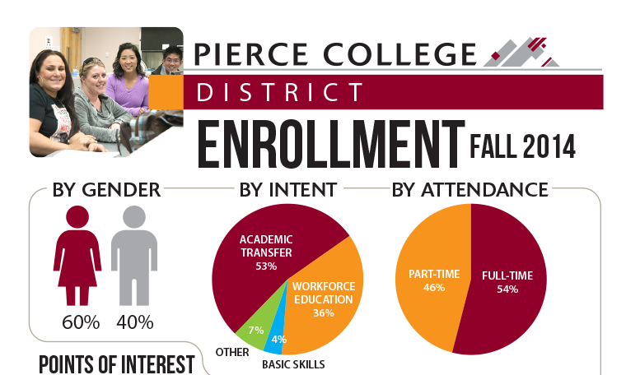

Slide 6
A bit more about me…
I’ve been at Pierce since 2012
Courses taught include
  College Success
  Reading
  INFO 101: Research Essentials (online)

Slide 7
A bit more about me…
I’ve been at Pierce since 2012
Courses taught include
  College Success
  Reading
  INFO 101: Research Essentials (online)

Slide 8
Getting to know one another
Introduce yourself to two other people
Please share
  Your name
  Your role in student learning
  Your experience teaching online

Slide 9

What are some struggles with reading in online courses?

Slide 10
Reading online is not the same as reading in print.

Slide 11
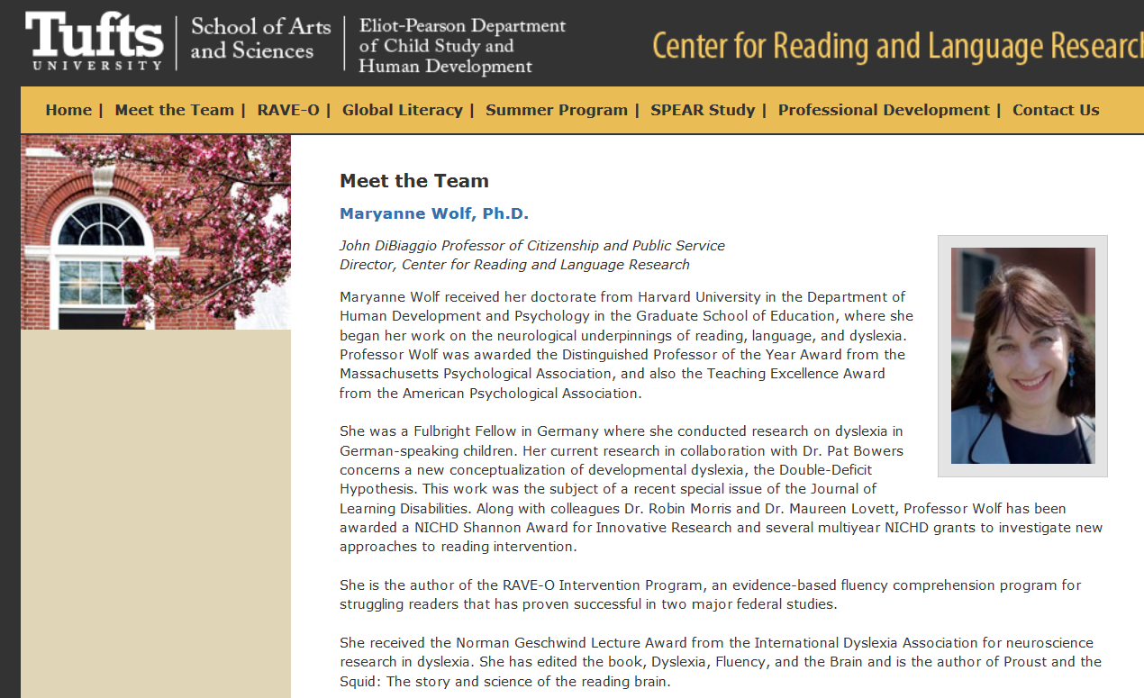

Slide 12
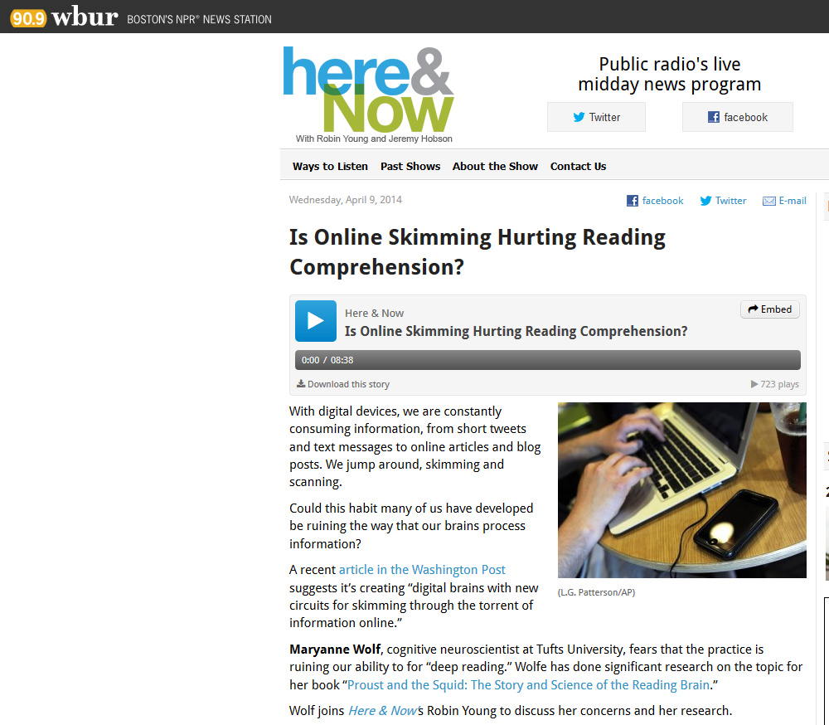

Slide 13

"We are not only what we read but how we read.”

Slide 14
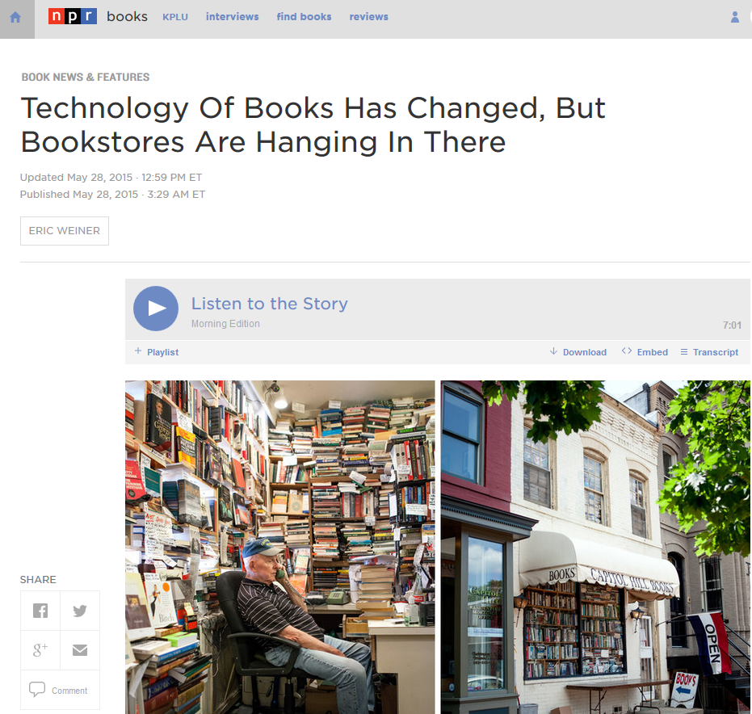

Slide 15
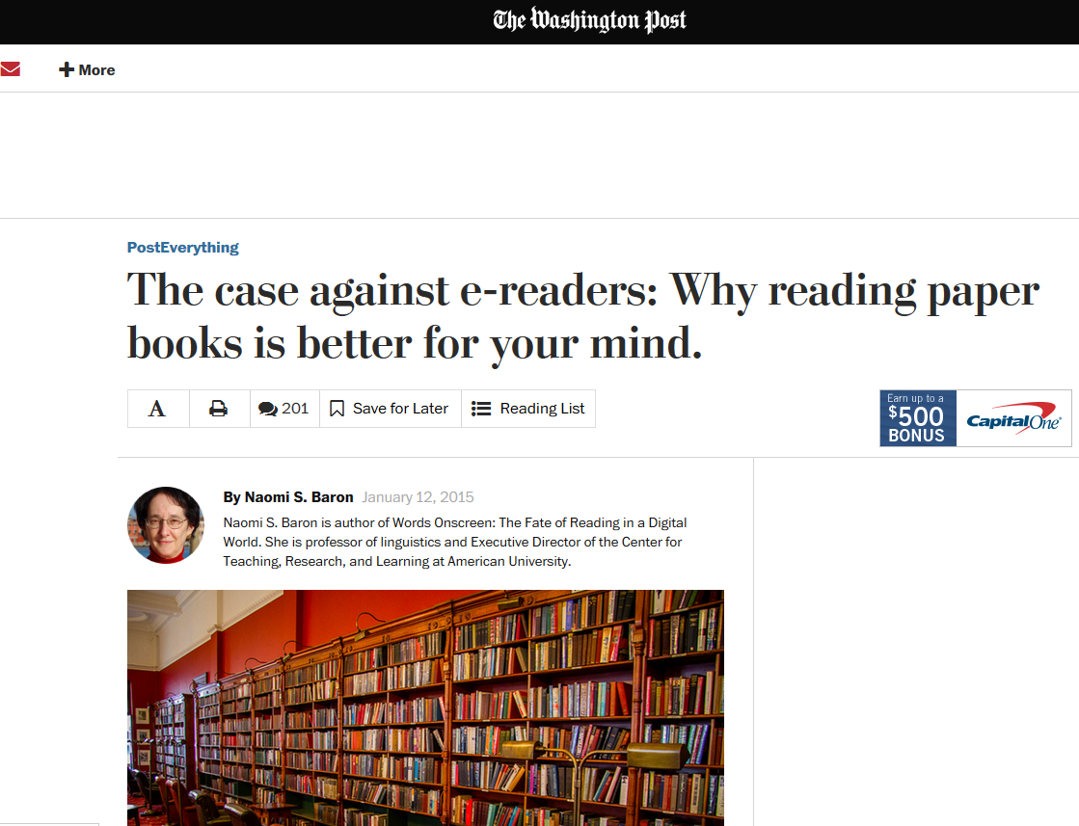

Slide 16

Naomi S. Baron
“Readers are human. If you dangle distractions in front of us (or if we know they are just a click or swipe away), it’s hard not to take the bait.”
Naomi S. Baron, “The Case Against E-readers” in The Washington Post

Slide 17
Five Steps to an RA Classroom (Online!)

Slide 18
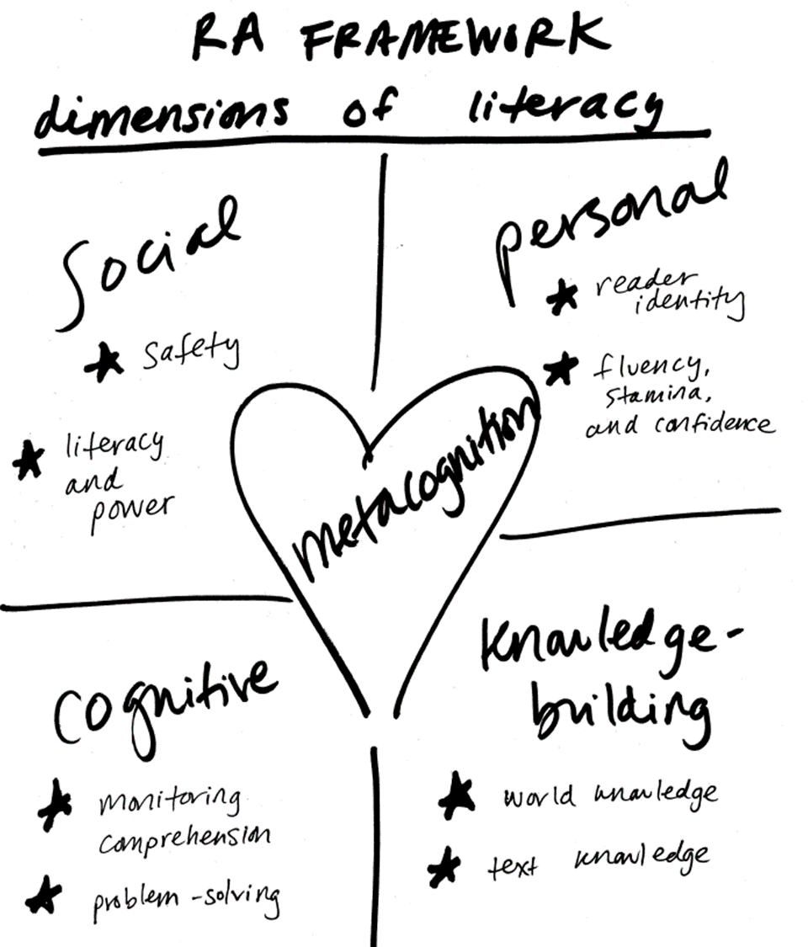

Slide 19
Five Steps to an RA Classroom (Online!)
Start the Conversation
Model the Routines
Use the Routines
Promote Learner Connections
Focus on Process

Slide 20
Five Steps to an RA Classroom (Online!)
Start the Conversation
Model the Routines
Use the Routines
Promote Learner Connections
Focus on Process

Slide 21
1. Start the Conversation
Students in an online course must acknowledge that their online reading habits are appropriate for casual reading, but not for online learning.

Slide 22
Start the Conversation
Assign a short article about reading in print versus paper.
Start a discussion about how online students read & study.
  Reading Strategies List!
Encourage students to post pictures of their study/work spaces.
Remind students to print out all readings & assignments.

Slide 23

Equity & Access
How can we level the playing field for online students who do not have access to printers?
How do we support students who are completing coursework on phones?

Slide 24
Five Steps to an RA Classroom (Online!)
Start the Conversation
Model the Routines
Use the Routines
Promote Learner Connections
Focus on Process

Slide 25
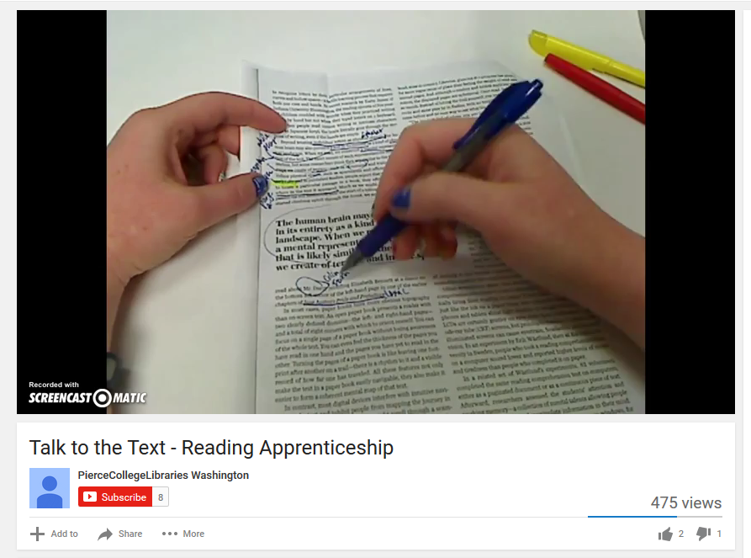
2. Model the Routines

Slide 26
Why is it important for you to model the routine (rather than using someone else’s videos)?

Slide 27
Five Steps to an RA Classroom (Online!)
Start the Conversation
Model the Routines
Use the Routines
Promote Learner Connections
Focus on Process

Slide 28
3. Use the Routines
Use discussion forums to promote metacognitive conversation.
Students can submit RA assignments online!

Slide 29

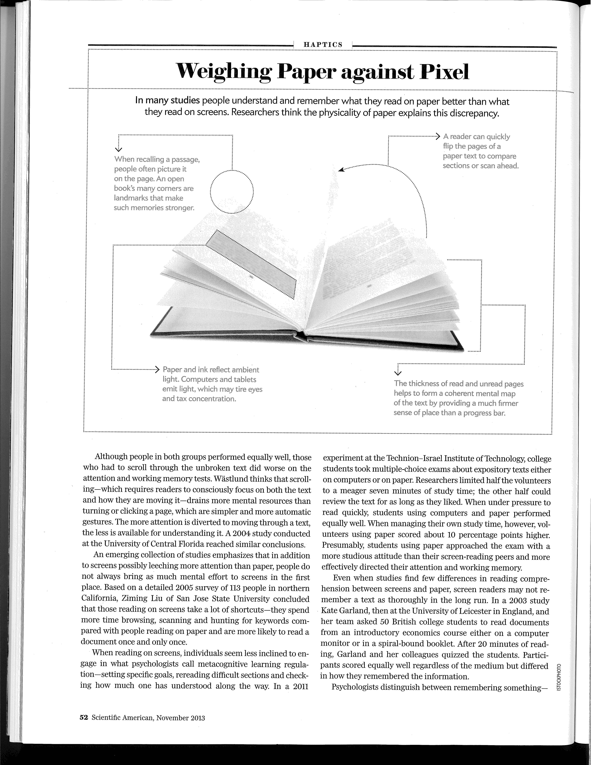
“Why the Brain Prefers Paper”

Slide 30
Discussion Forum Prompts
In your discussion post, please address all of the following prompts by writing full sentences in paragraphs:
What questions/concerns/problems came up for you during your reading? What do you want to know more about?

Slide 31
Discussion Forum Prompts
Share your golden line and explain why you chose it. Why was this particular sentence so meaningful or important to you? (Be sure to include the page number [49-53] so we can find your line!)

Slide 32
Discussion Forum Prompts
The author mentions several studies/experiments in his article. Which study or experiment was most interesting to you and why?
Do you notice a difference in your reading habits on screen versus on paper? Which do you prefer and why?

Slide 33
Discussion Forum Prompts
From your perspective, why are we reading this article in a research class? How does this article relate to the topics of this course? How could this article help someone become a better learner and researcher?
With your post, please attach a scanned copy of the article showing your work (e.g., we want to see how you Talked to the Text with your article, so your attachment should show all of your comments, questions, underlining, highlighting, etc.).

Slide 34
Discussion Forum Prompts
Your Reading Process
What were some new words/phrases that you learned from the readings? Provide at least 1-2 new words/terms and their definitions. (You may have learned the definitions from the readings or by looking up their meanings in a separate source.)
What questions/problems came up for you during these readings? At this point, what are you curious about or wanting to understand better?
Your Golden Line
In the interview with Emily Knox, choose one sentence from her interview as your "golden line"--a "golden line" is a sentence that seems particularly important or meaningful to you. Which sentence is your golden line and why was it so interesting or meaningful for you?

Slide 35
How to Submit RA Assignments
If handwritten…
  Scan and upload as a PDF.
  Take picture with your phone and upload.
Reading Logs can be typed!
Other ideas?

Slide 36
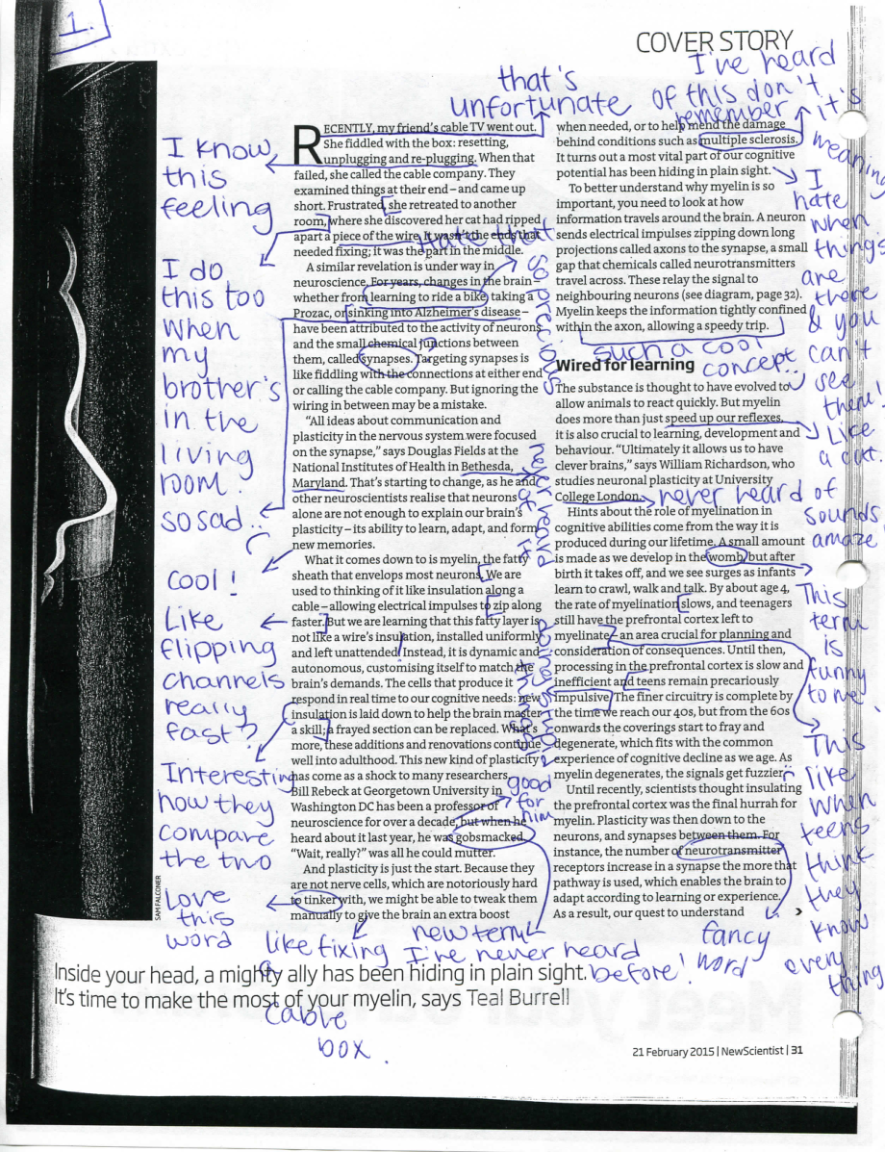
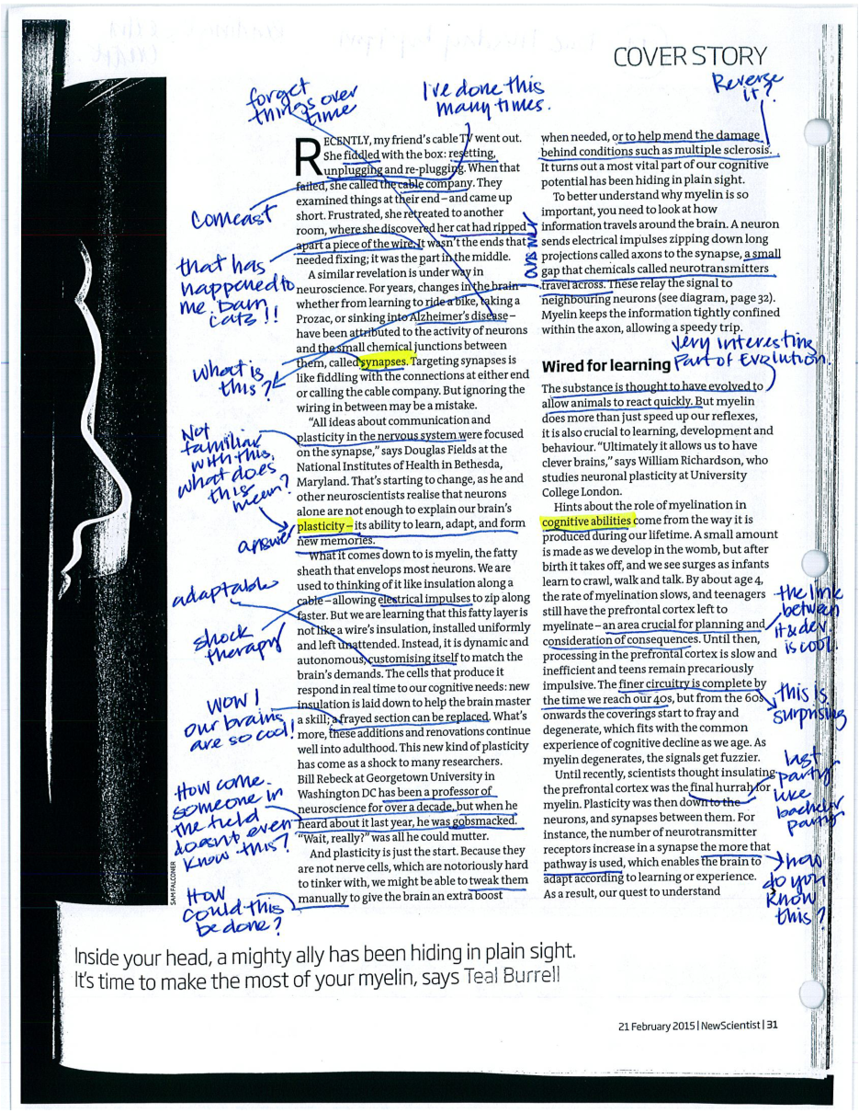
Student Samples

Slide 37
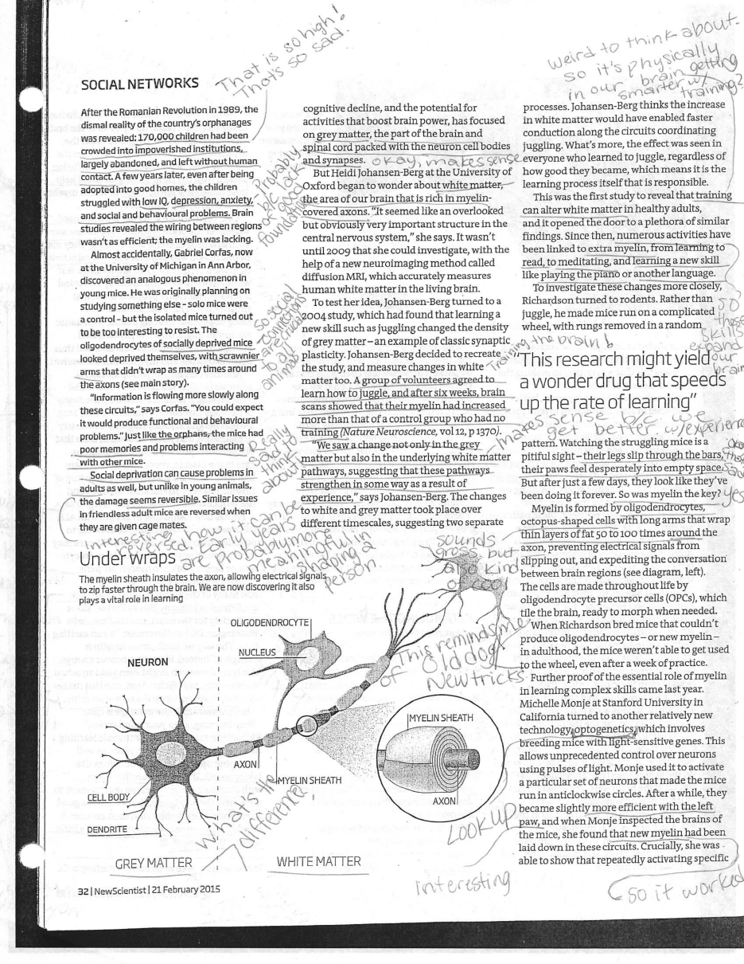
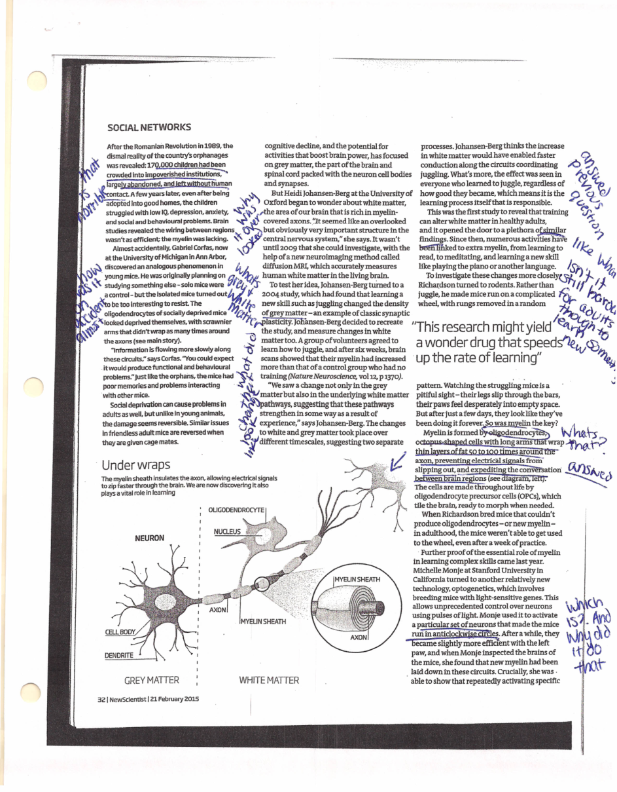
Student Samples

Slide 38
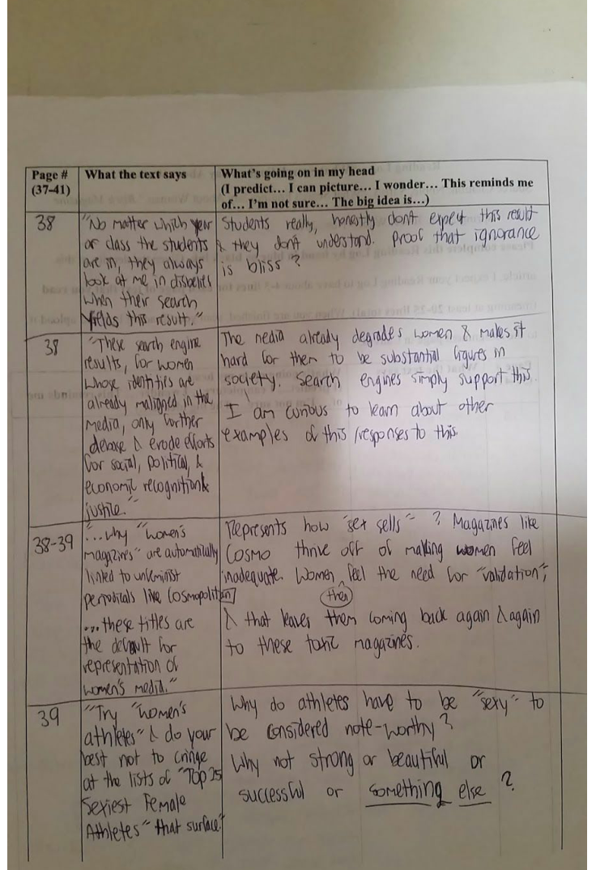
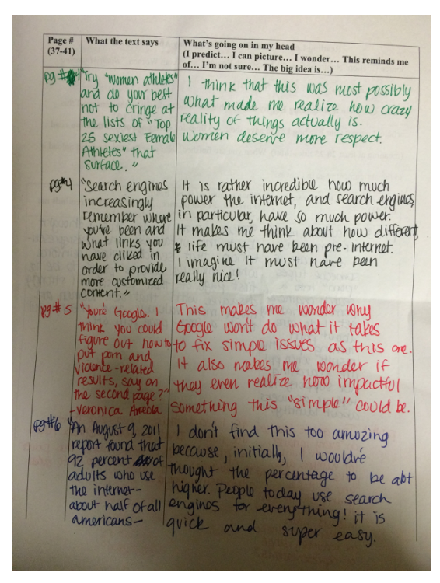
Student Samples

Slide 39
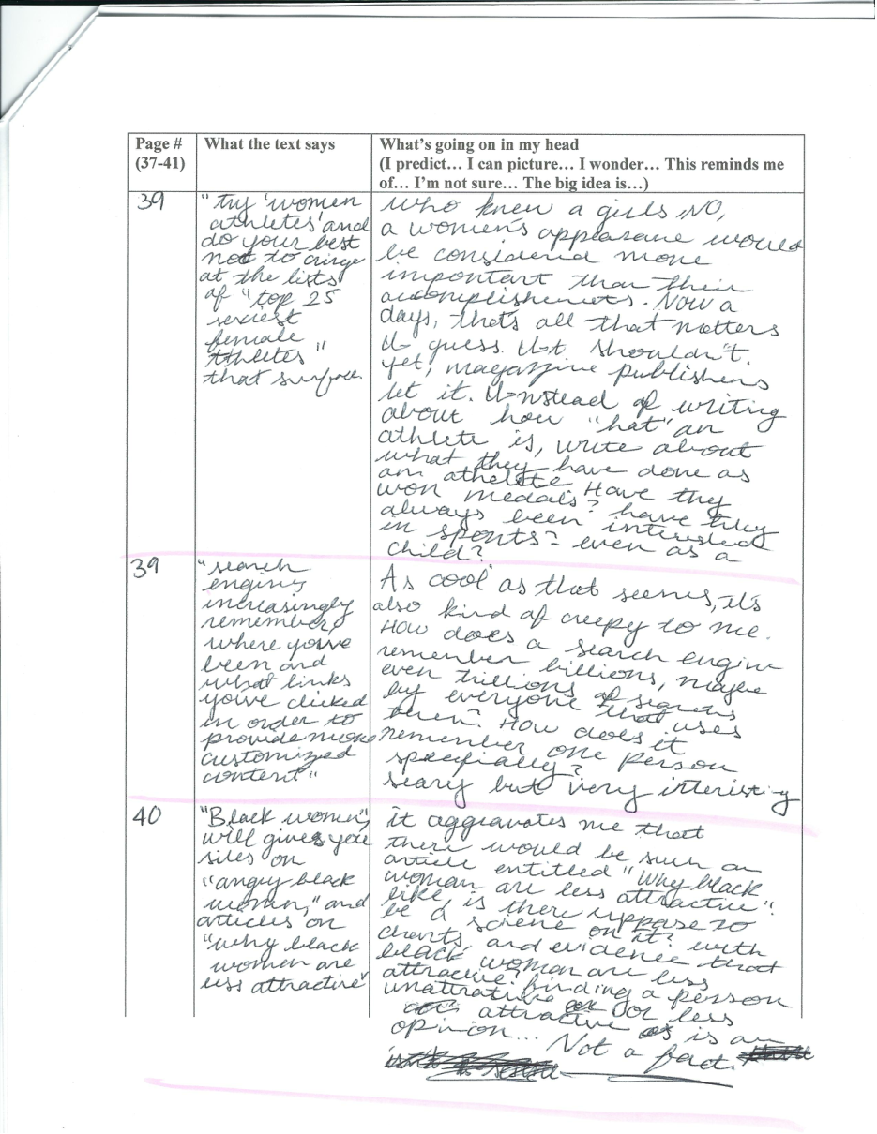
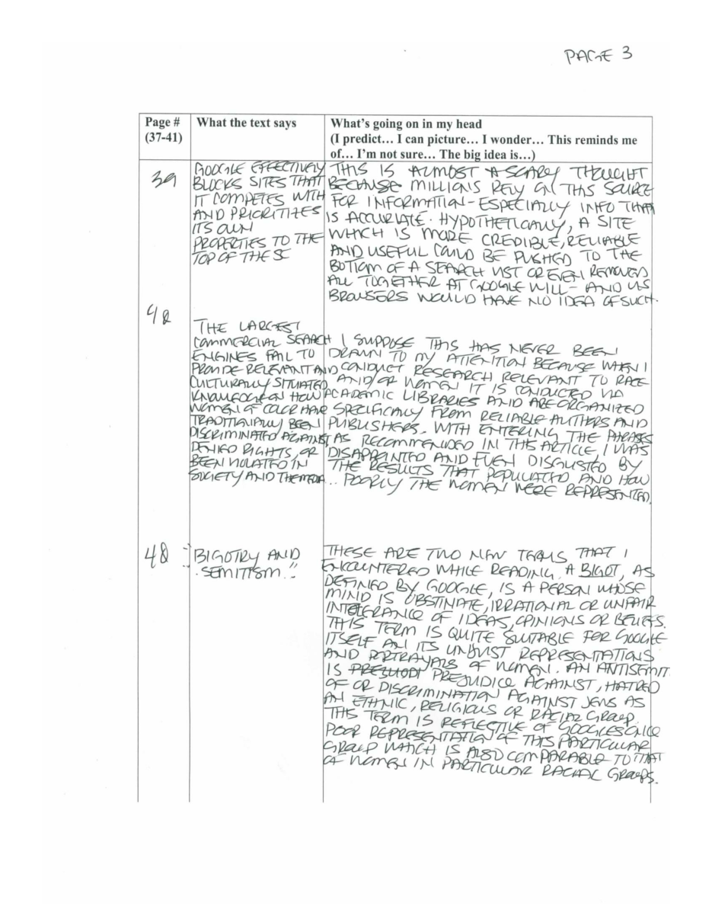
Student Samples

Slide 40
Do you think you could have students submit work online?

Slide 41
Five Steps to an RA Classroom (Online!)
Start the Conversation
Model the Routines
Use the Routines
Promote Learner Connections
Focus on Process

Slide 43

4. Promote Learner Connections
In lieu of an online discussion forum, ask students to connect with one another outside of class in real time (no e-mailing, texting, etc.).

Slide 44
4. Promote Learner Connections
The idea of the “online student” is misleading.

Slide 45
4. Promote Learner Connections
A very small percentage of students are enrolled in completely online programs.
Most students in online classes are also taking face-to-face classes on campus.

Slide 46
4. Promote Learner Connections
As of Fall 2013…
14.8% of 4-year college students were enrolled in a completely online degree program
9.8% of 2-year college students were enrolled in a completely online degree program
27% of students take any online courses as part of their degree
73% of students are not taking online classes
SOURCE: U.S. Department of Education, National Center for Education Statistics, Integrated Postsecondary Education Data System (IPEDS), Spring 2013 and Spring 2014, Enrollment component. (This table was prepared December 2014.)

Slide 47
4. Promote Learner Connections
In the submission box, please provide the following information. To receive full points for this assignment, you must turn in this assignment on time and respond to all of the following questions indicating that you completed this task successfully.
Which classmate did you speak with?
When did you connect (date/time)?
How did you connect? By phone call, in person, via Skype/Face Time, or another tool? (Please note that texting, e-mailing, or messaging are usually not appropriate for this assignment--please contact me for exceptions to this.)
What did you learn about your classmate? What are they planning to research? What do they hope to learn? Why is this topic important/interesting to them?

Slide 48
Would you be willing to try a Learner Connection in your online class?

Slide 49
Five Steps to an RA Classroom (Online!)
Start the Conversation
Model the Routines
Use the Routines
Promote Learner Connections
Focus on Process

Slide 50
5. Focus on Process
Modify and use the Curriculum-Embedded Reading Assessment (CERA) as a recurring assignment.

Slide 51
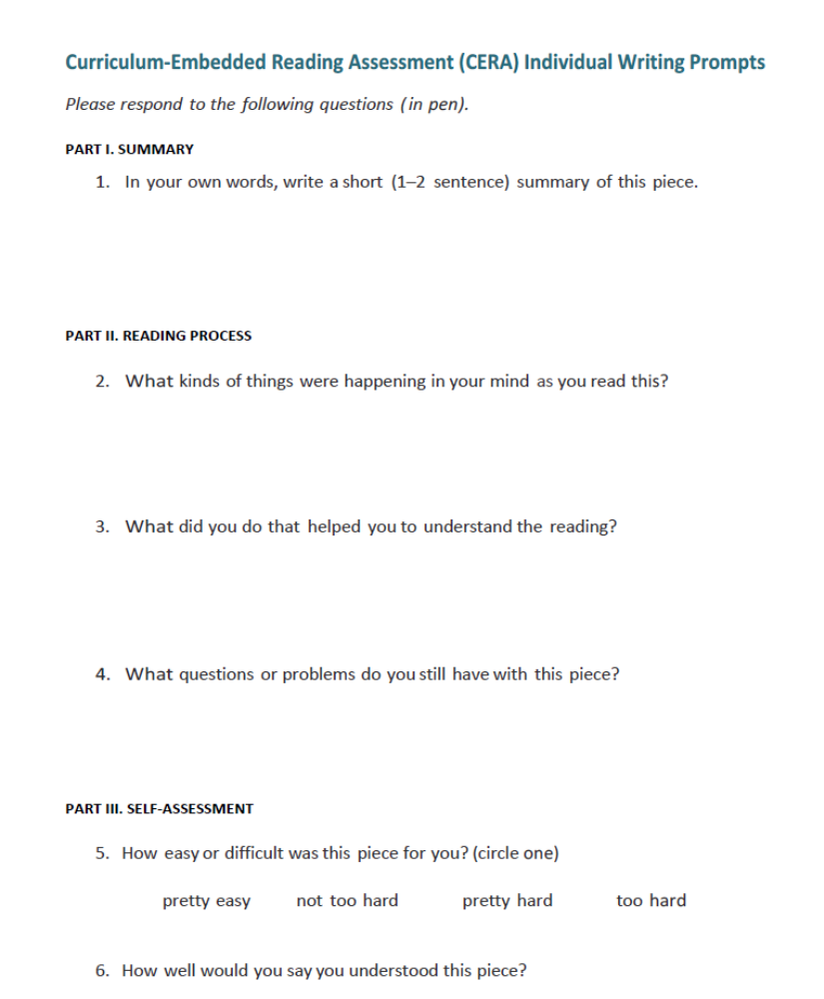

Slide 52
Reading Questions
Write a 1-2 sentence summary of this piece.
What was going through your mind as you read this piece?
What did you do that helped you understanding the reading?
What questions or problems do you have with this piece?
What was your golden line from the reading? Why?
2-3 additional questions based on the content of the reading.

Slide 53
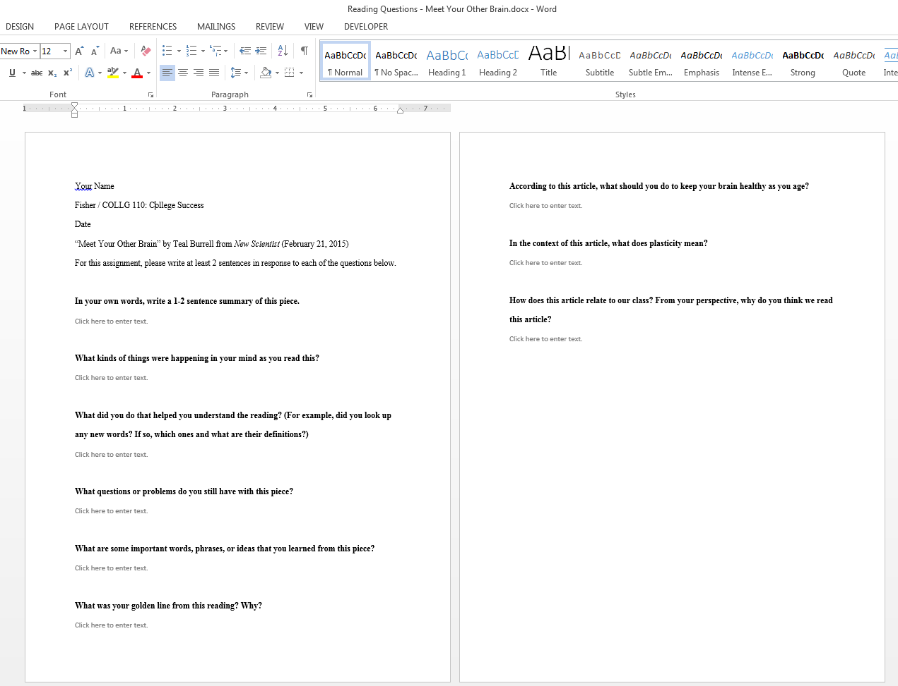

Slide 54
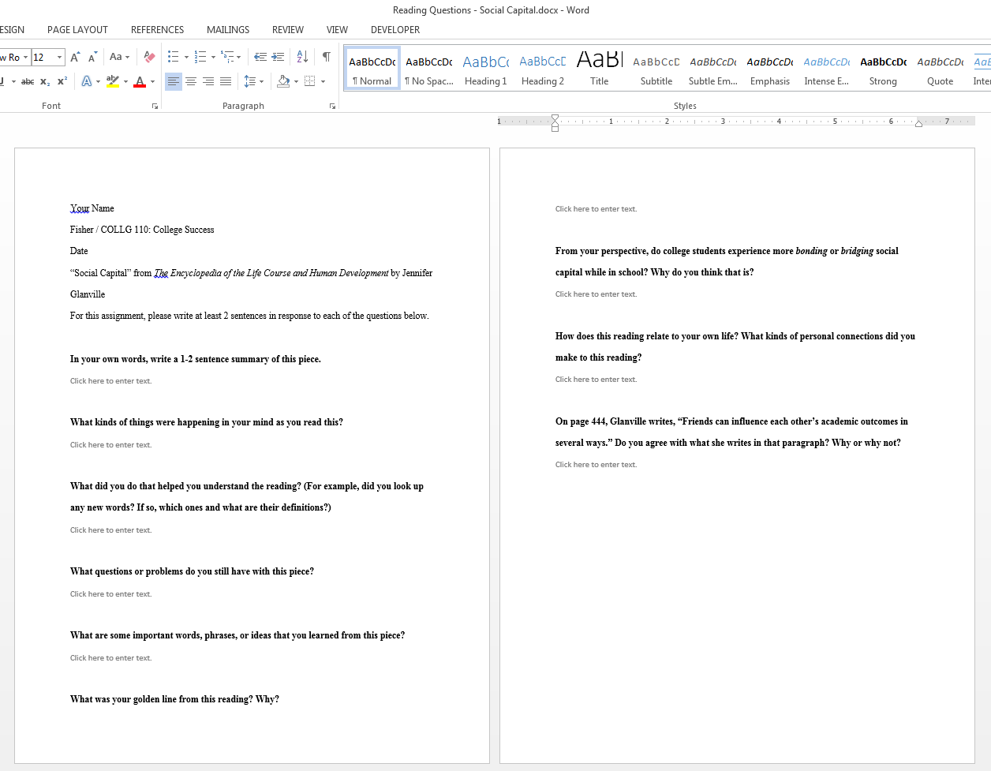

Slide 55
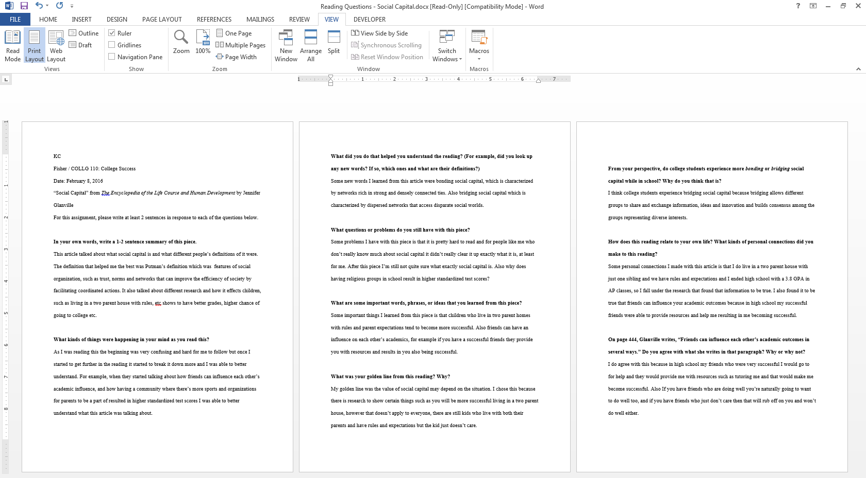

Slide 56
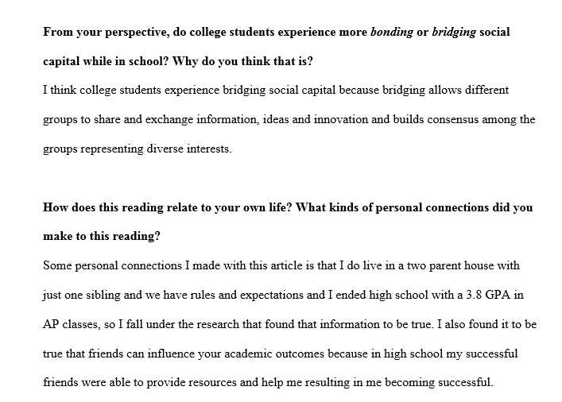

Slide 57
Five Steps to an RA Classroom (Online!)
Start the Conversation
Model the Routines
Use the Routines
Promote Learner Connections
Focus on Process

Slide 58
What will you do differently based on what you learned today?

Slide 59

Questions/Discussion
Click, Click, Metacognition!
How to Use Reading Apprenticeship in the Online Classroom
Zoe Fisher
Reference & Instruction Librarian
March 12, 2016
zfisher@pierce.ctc.edu
@zoh_zoh
about.me/zoefisher

