Slide 1
Pack Your Bags with Metacognition!
Embedding Reading Skills in the Online Information Literacy Classroom
Zoe Fisher
Associate Professor, Reference & Instruction Librarian
Pierce College
Puyallup, Washington
@zoh_zoh

Slide 2
Today’s Outcomes
After today’s session, you will be able to…
Define metacognition
Define Reading Apprenticeship & its four dimensions of literacy
Use the metacognitive reading log
Reflect on how you incorporate reading skills in information literacy

Slide 3
Getting to Know Your Colleagues
Introduce yourself to two other people you haven’t met yet
Please share
  Your name & institution
  Your role in student learning
  Your experience teaching (one-shots, credit courses, online?)

Slide 4

What are some of the reading struggles that you see in your students?

Slide 5
Struggling readers often have poor metacognition.

Slide 6
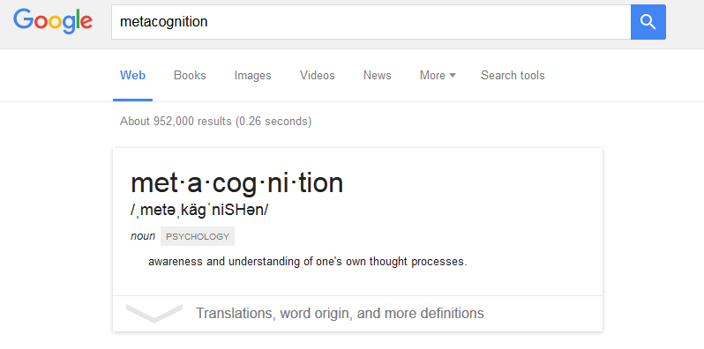
Metacognition

Slide 7
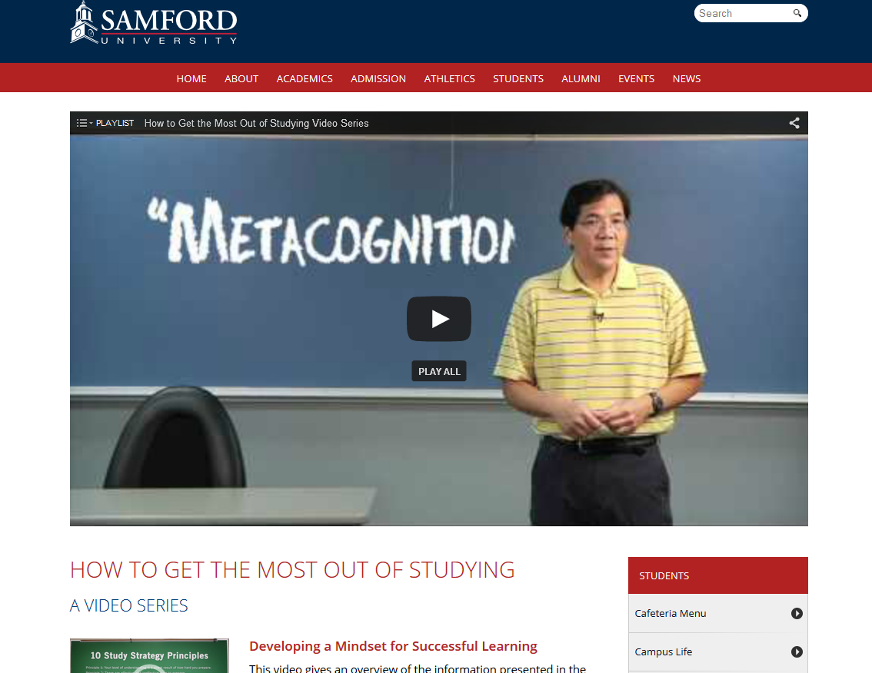
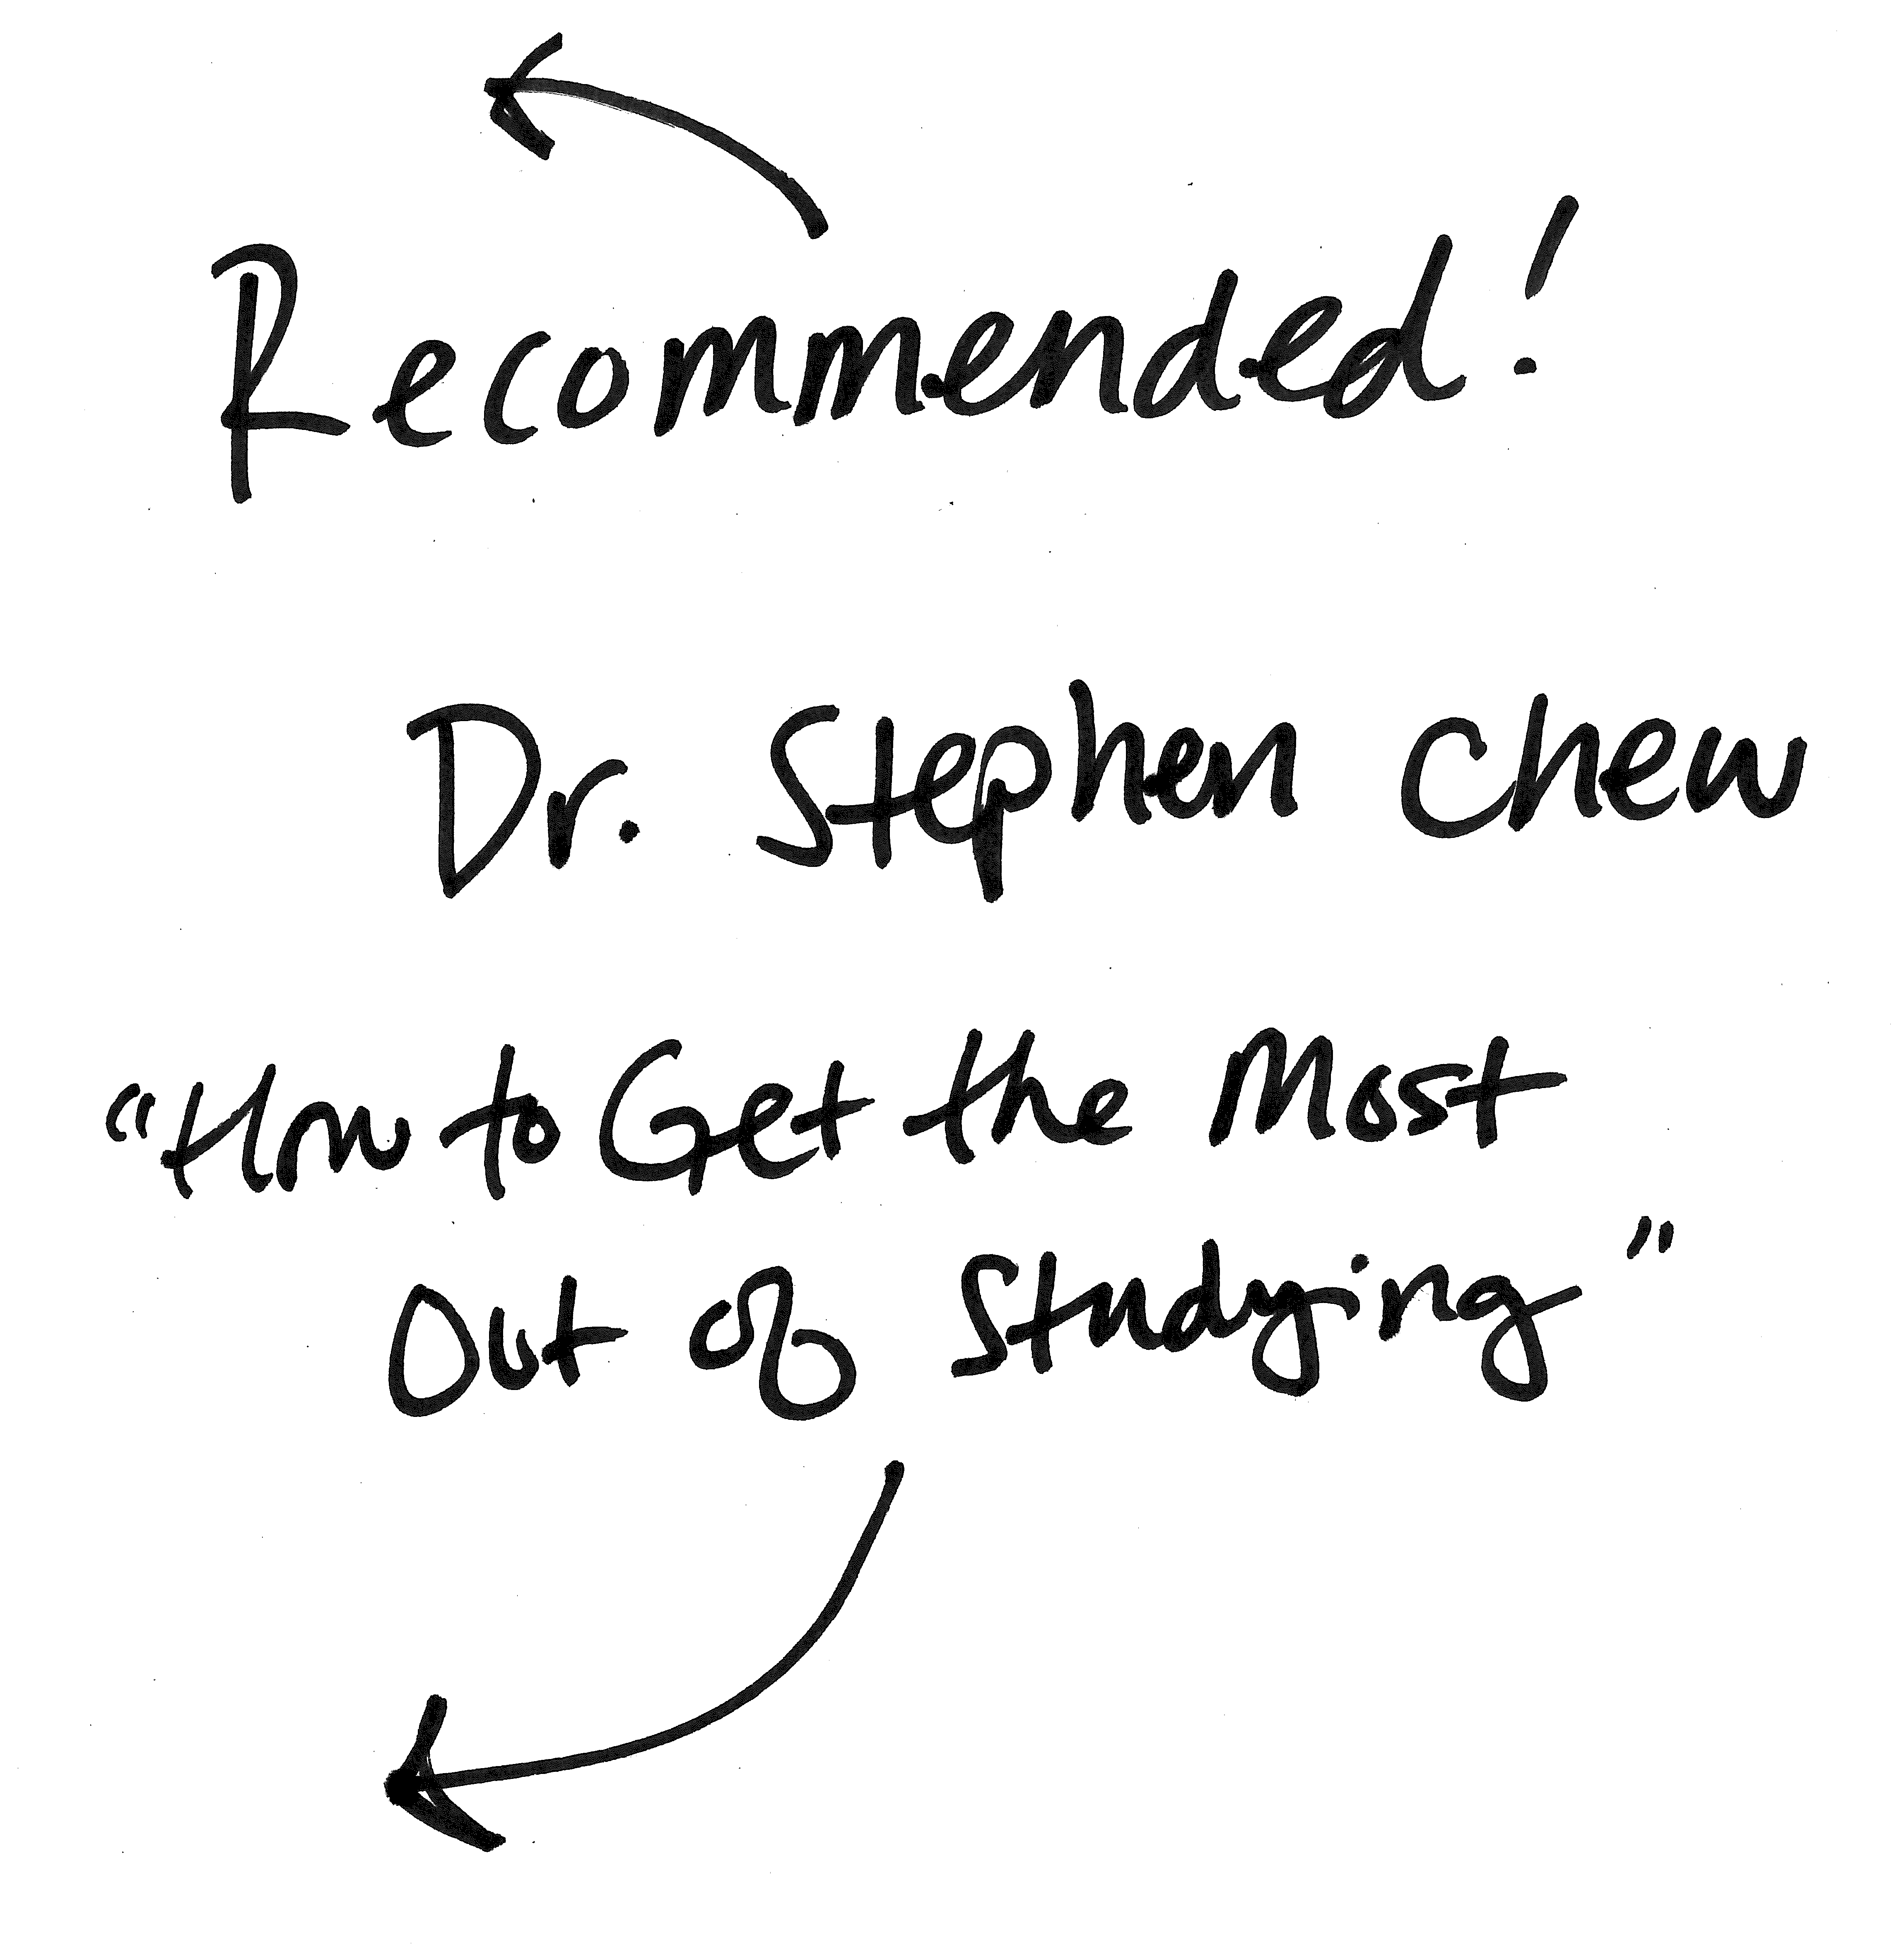

Slide 8
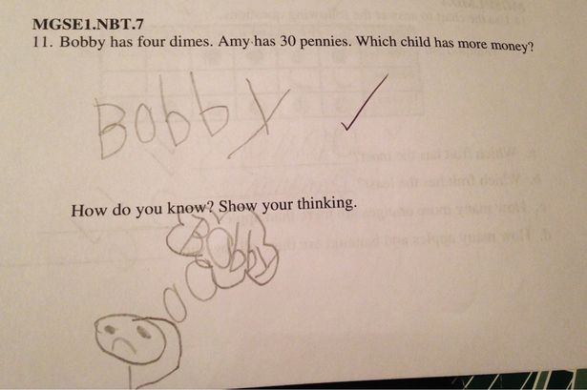
Show Your Thinking

Slide 9
Show Your Thinking

Slide 10
Reading Apprenticeship
http://www.readingapprenticeship.org/
A framework for developing literacy skills in higher education

Slide 11
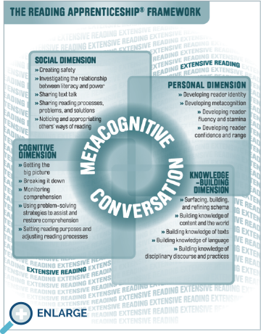

Slide 12
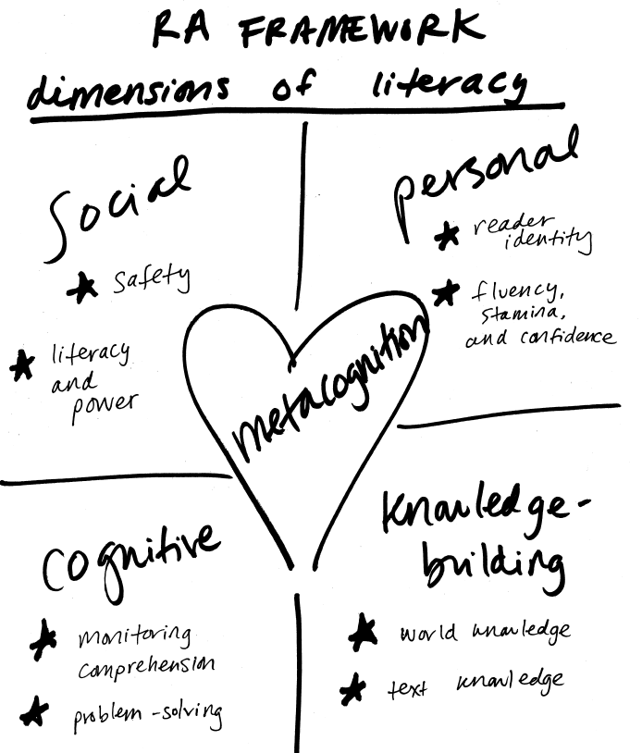

Slide 13
Today’s Outcomes
After today’s session, you will be able to…
Define metacognition
Define Reading Apprenticeship & its four dimensions of literacy
Use the metacognitive reading log
Reflect on how you incorporate reading skills in information literacy

Slide 14
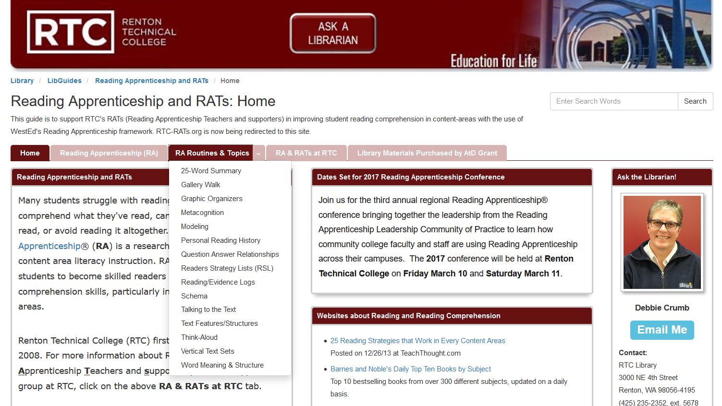
http://libguides.rtc.edu/rats

Slide 15
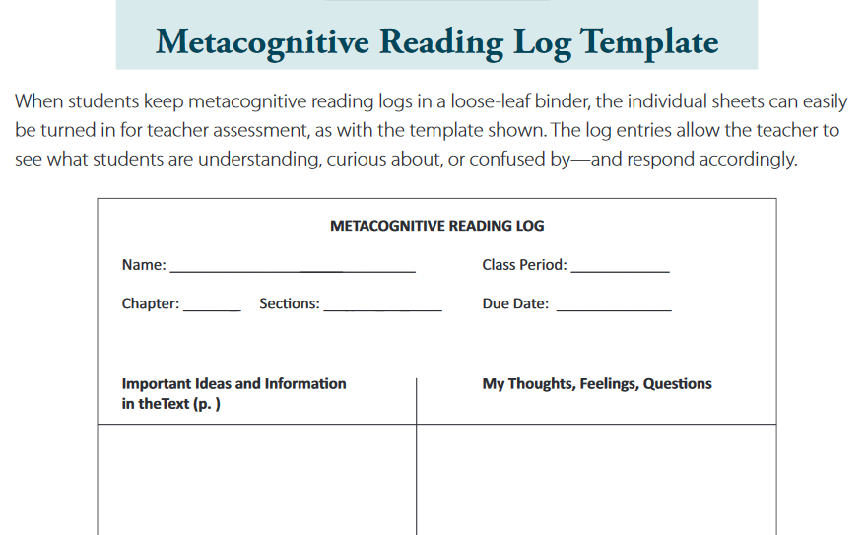
Metacognitive Reading Log

Slide 16
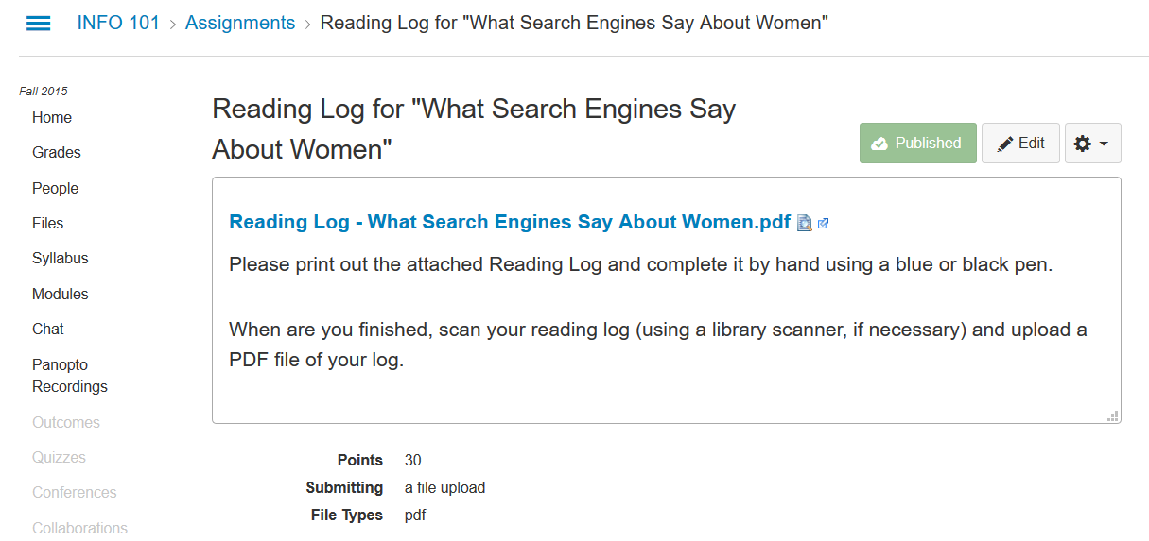

Slide 17
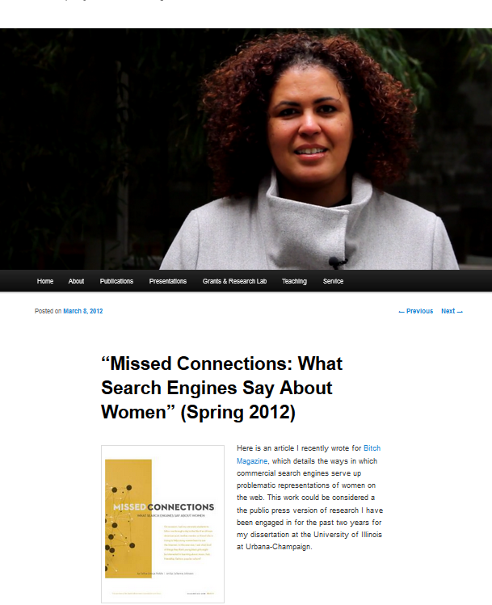
www.safiyaunoble.com

Slide 18
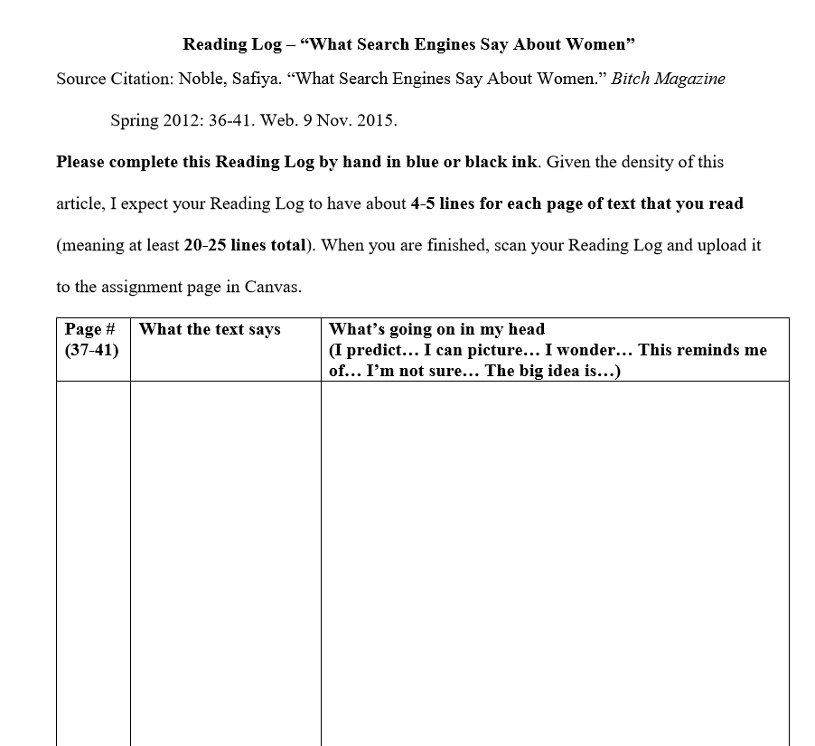

Slide 19
Try to write 2-4 entries in your reading log.

Slide 20
What did you write in your reading log? Why?

Slide 21
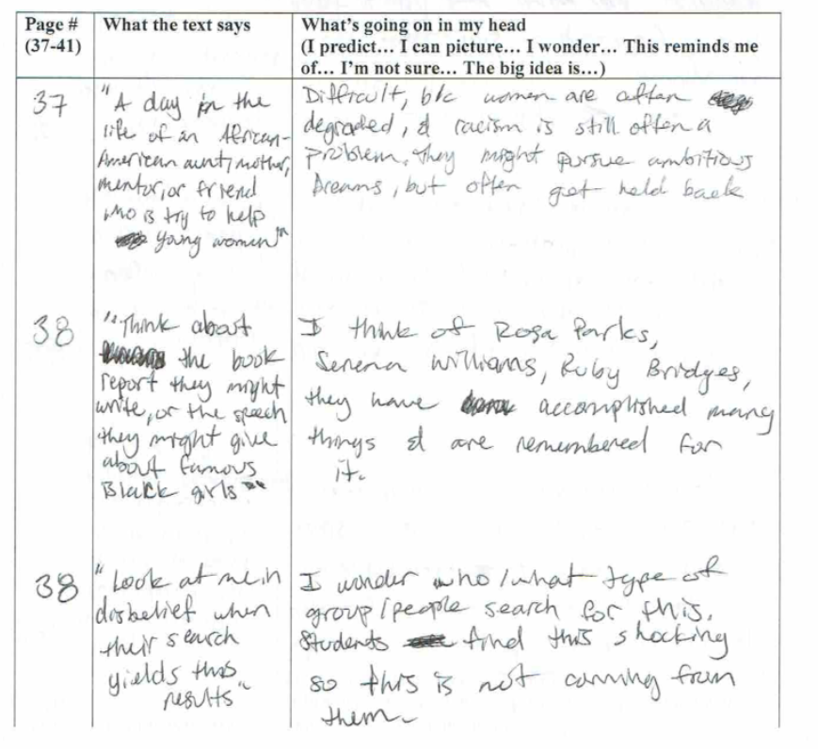

Slide 22
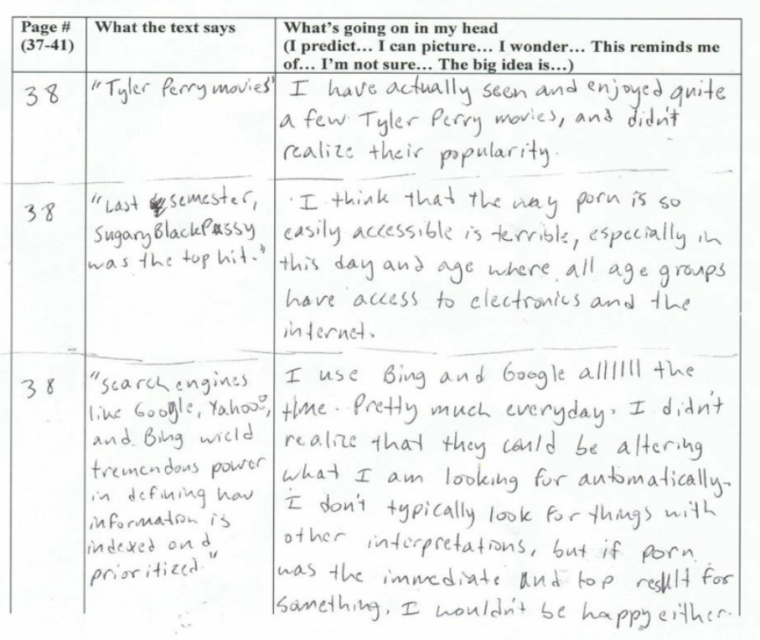

Slide 23
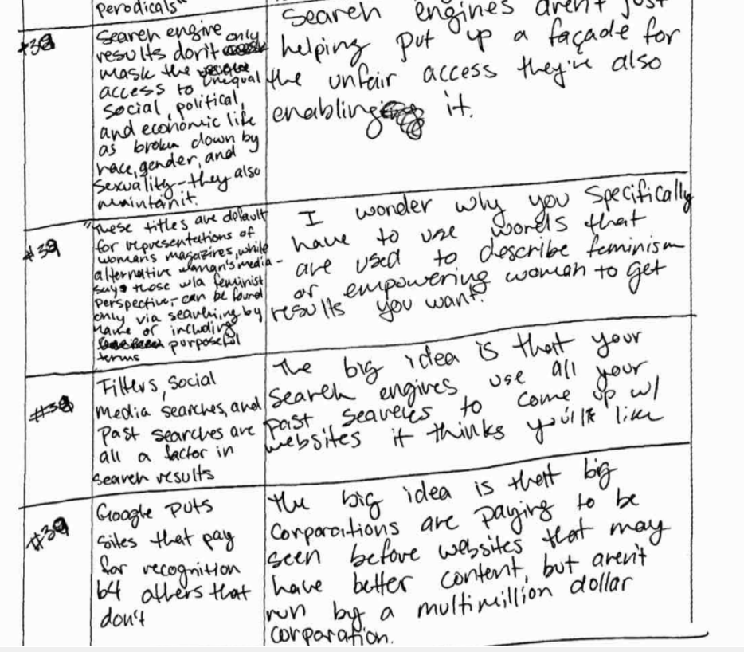

Slide 24
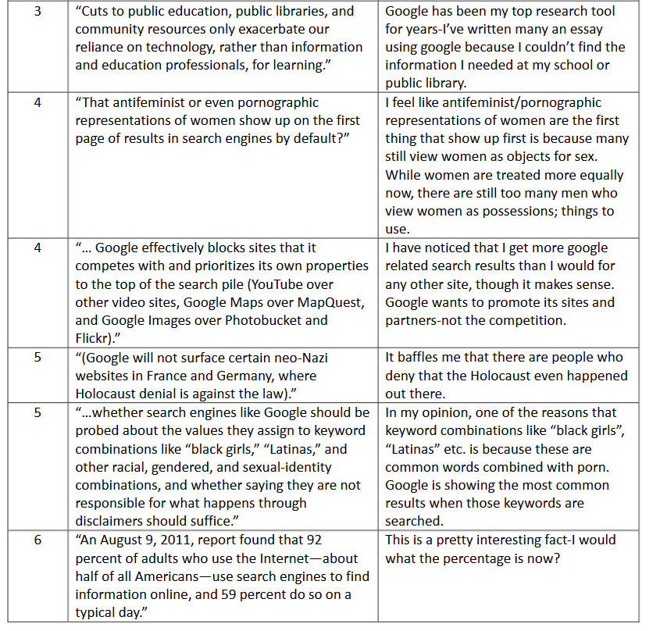

Slide 25
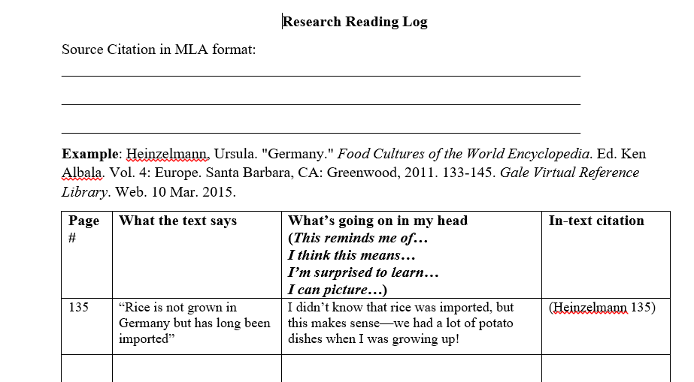
Research Reading Log

Slide 26
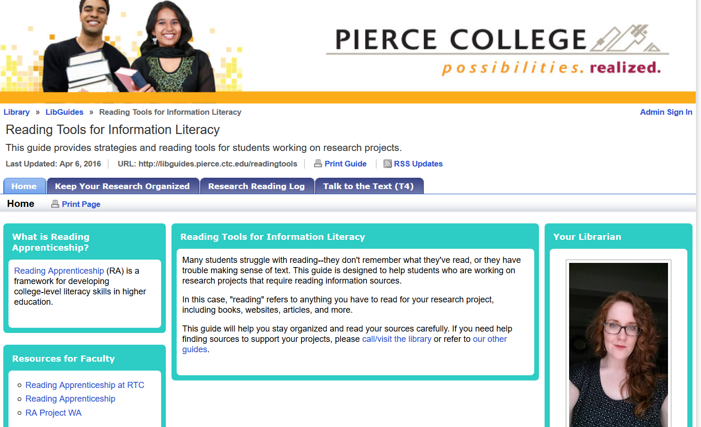
http://libguides.pierce.ctc.edu/readingtools

Slide 27
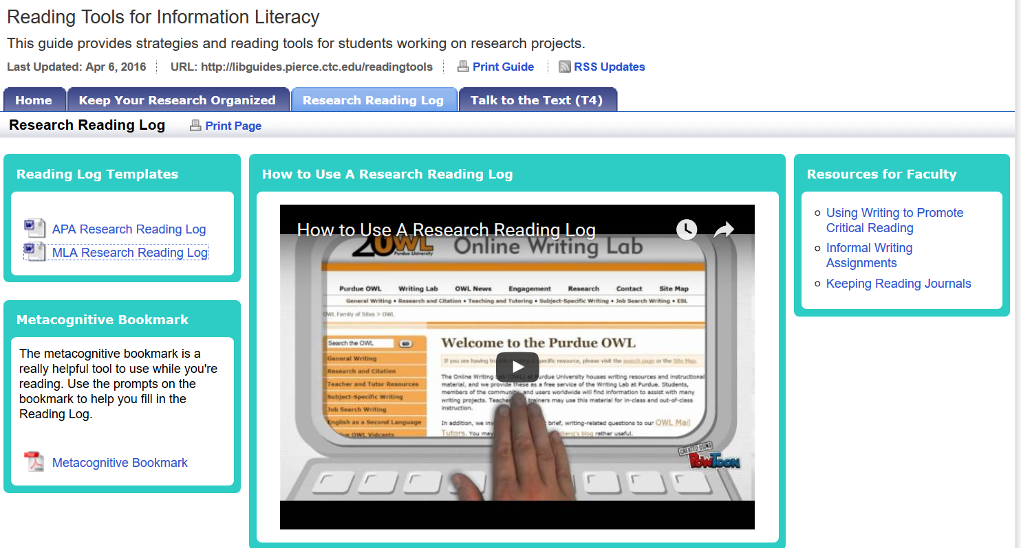
http://libguides.pierce.ctc.edu/readingtools

Slide 28
What will you do differently based on what you learned today?

Slide 29
Thank you!
Resources
Stephen Chew
“How to Get the Most out of Studying”
Reading Apprenticeship
www.readingapprenticeship.org
RA Routines
http://libguides.rtc.edu/rats
Reading Tools for Information Literacy
http://libguides.pierce.ctc.edu/readingtools
Zoe Fisher
zfisher@pierce.ctc.edu
@zoh_zoh

