Slide 1

“Unsuited for Age Group”
Queer Youth Survival & the Freedom to Read
Zoe Fisher, Assistant Professor
September 29, 2016

Slide 2
Today’s Outcomes
You will be able to…
Identify librarians who have fought for intellectual freedom
Explain the theme of this year’s Banned Books Week
Value the freedom to read as a life-saving necessity

Slide 3
Librarians
Books
Survival

Slide 4
Librarians

Slide 5
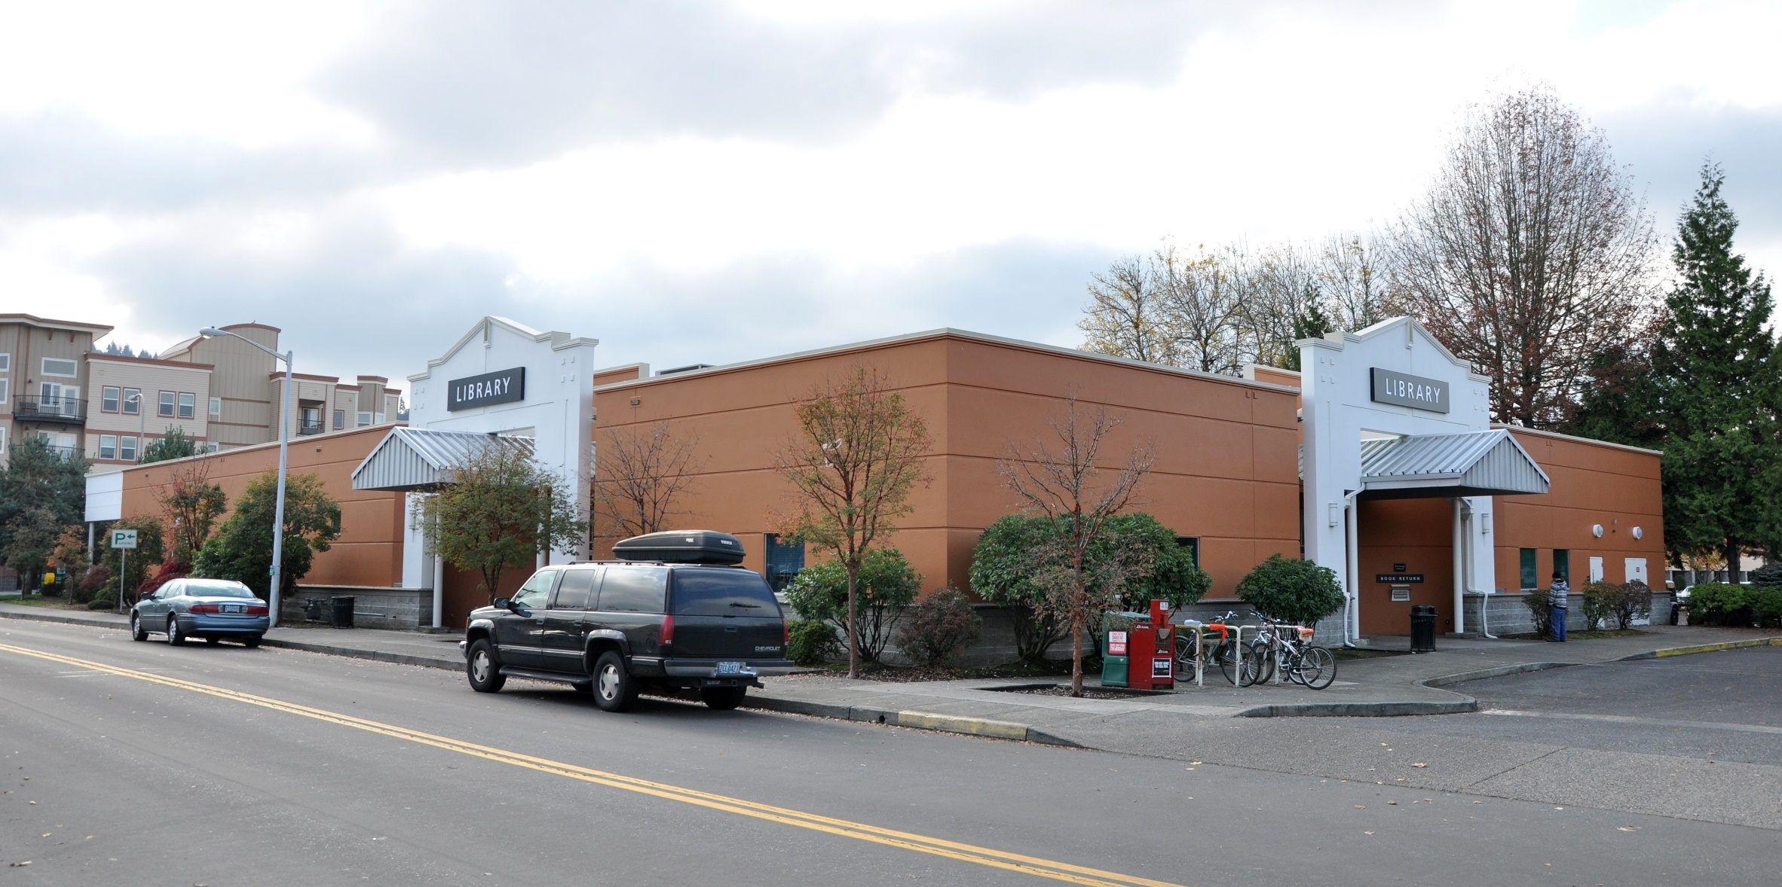

Slide 6
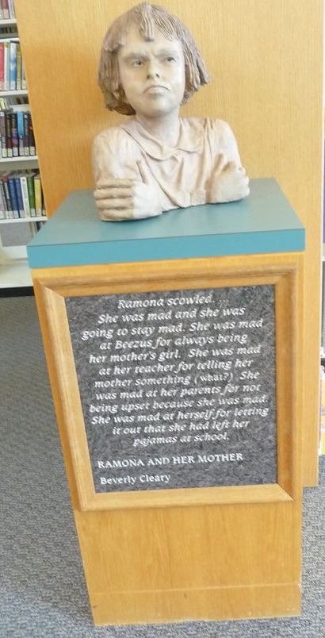

Slide 7
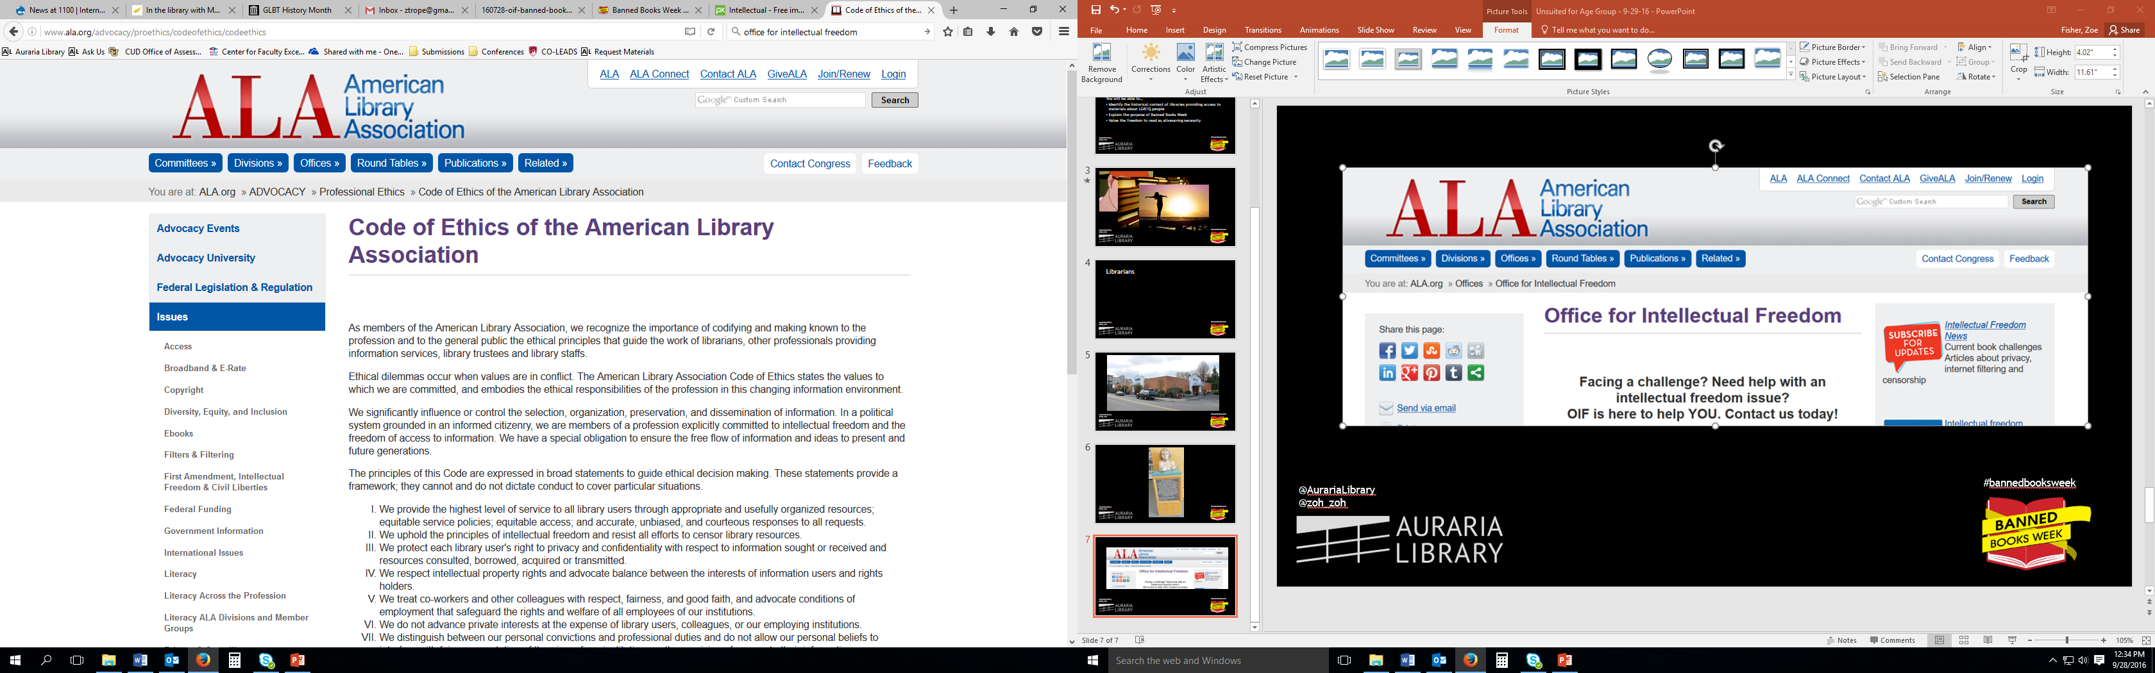

Slide 9
Intellectual Freedom
The American Library Association advocates and educates in defense of intellectual freedom—the rights of library users to read, seek information, and speak freely as guaranteed by the First Amendment.
Source: http://www.ala.org/advocacy/intfreedom

Slide 10
Intellectual Freedom
The American Library Association advocates and educates in defense of intellectual freedom—the rights of library users to read, seek information, and speak freely as guaranteed by the First Amendment.
Source: http://www.ala.org/advocacy/intfreedom

Slide 11
Librarian Heroes

Slide 12
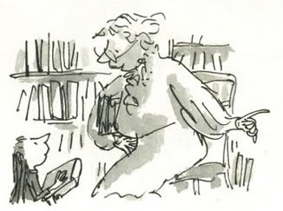

Slide 13


Slide 14
“And don't worry about the bits you can't understand. Sit back and allow the words to wash around you, like music.”
– Mrs. Phelps, librarian, in Matilda by Roald Dahl

Slide 15
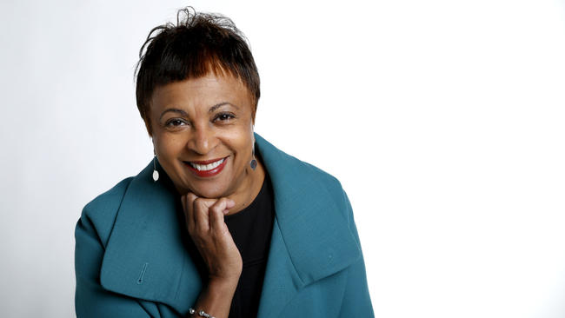

Slide 16
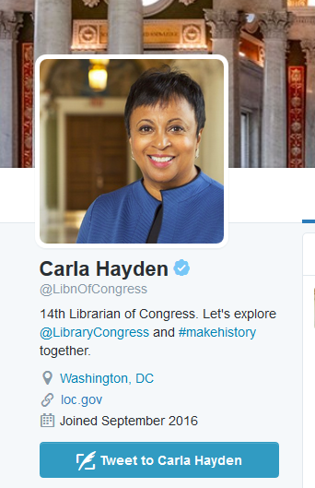
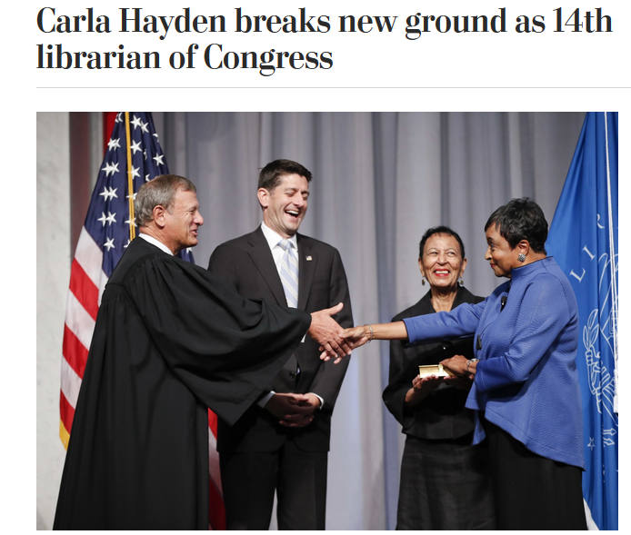

Slide 17
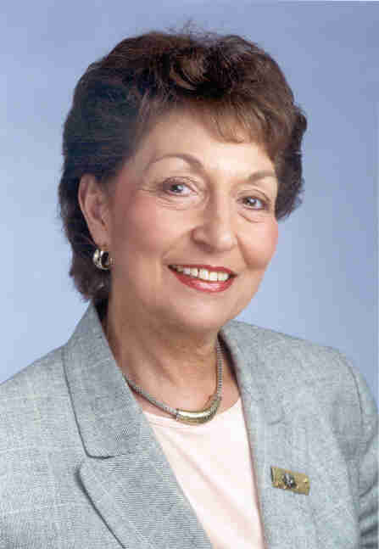
Judith Krug
1940-2009

Slide 18
1967 – Became the director of the Office for Intellectual Freedom
1982 – Co-founded Banned Books Week
1997 – Fought for unfiltered Internet access in libraries
2005 – Spoke out against the Patriot Act

Slide 19
The following excerpt is from the April 14, 2009 New York Times article by Douglas Martin…

Slide 20
Ms. Krug credited her parents as inspiring her passion for free expression. In 2002, she told The Chicago Tribune about reading a sex-education book under the covers with a flashlight when she was 12.

Slide 21
“It was a hot book; I was just panting,” she said, when her mother suddenly threw back the bed covers and asked what she was doing. Judith timidly held up the book.

Slide 22
“She said, ‘For God’s sake, turn on your bedroom light so you don’t hurt your eyes.’ And that was that,” Ms. Krug said.

Slide 23
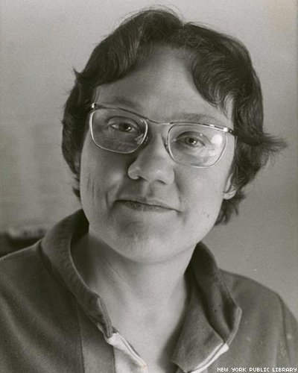
Barbara Gittings
1932-2007

Slide 24
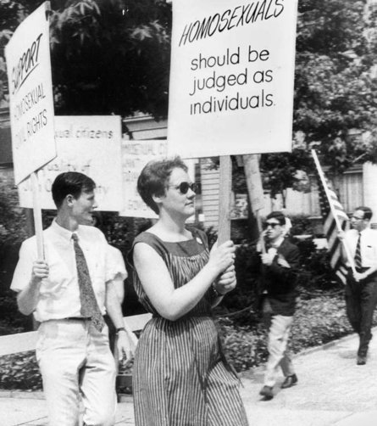

Slide 25
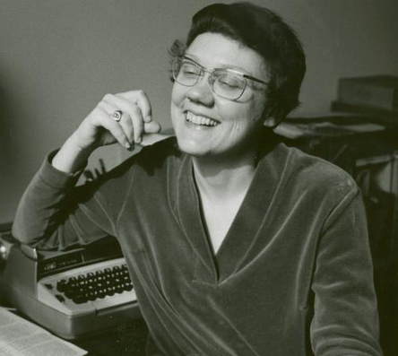
1950s – Founded the first national organization for lesbians
1960s – Organized and led demonstrations for gay rights at the White House, the Pentagon, and Independence Hall
1970s – Lobbied the American Psychiatric Association to remove homosexuality as a mental disorder (rescinded in 1973)
1971-1986 – Coordinator of the ALA Gay Task Force

Slide 26
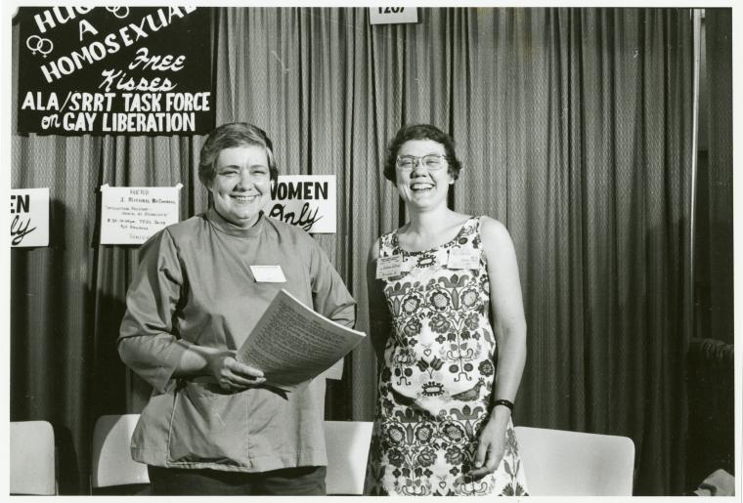

Slide 27
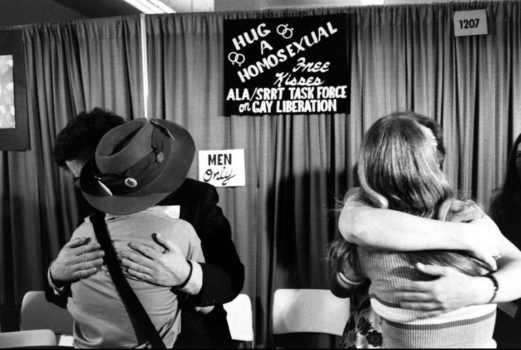

Slide 28
“As a teenager, I had to struggle alone to learn about myself and what it meant to be gay.”

Slide 29
Books

Slide 30










Slide 32
Think about a book you’ve read that featured a main character who was totally different from you.

Slide 33
What was that book?

Slide 34


Slide 35
Judith Platt, director of free expression advocacy at the Association of American Publishers
“Banning books by diverse authors, or books dealing with people or situations that are unfamiliar or strange to the majority of Americans, creates fear rather than promoting understanding. Young people especially need books that shed light on a diversity of experience, background, culture, gender, and religion.”

Slide 36
Judith Platt, director of free expression advocacy at the Association of American Publishers
“Books that feature people of color, people with disabilities and people seeking answers to questions about gender identity create opportunities for learning and openness. This is the only way we can ever hope to stop being ‘them and us’ and become ‘we’.”

Slide 37

Banned Books Week

Slide 38
What is the most common reason books are challenged?
Nudity
Violence
Satanism
Offensive Language
Sexually Explicit

Slide 39
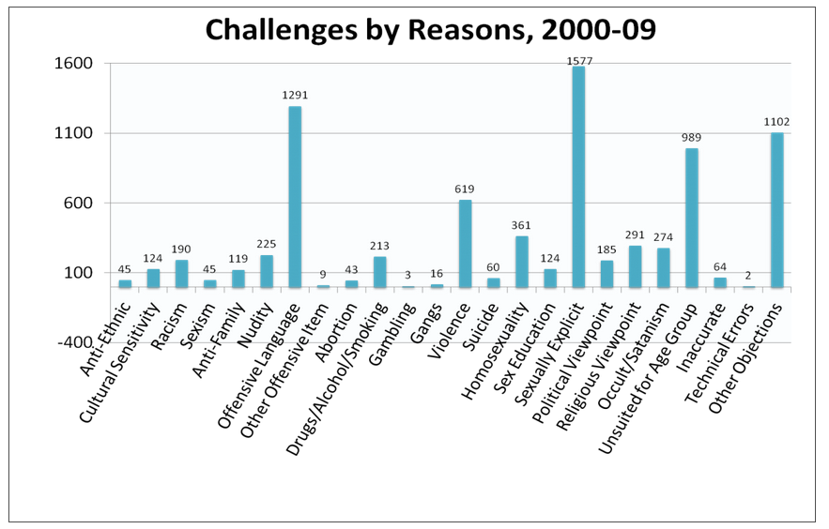

Slide 40
Who initiates book challenges?
Teachers
Parents
School administrators & principals
Clergy

Slide 41
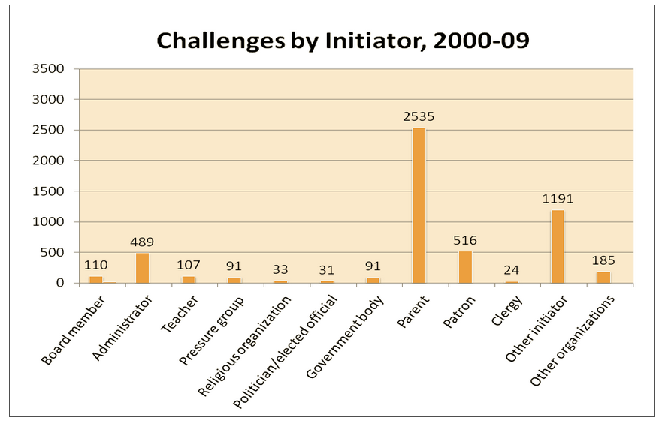

Slide 42
How have recent events affected book challenges?

Slide 44
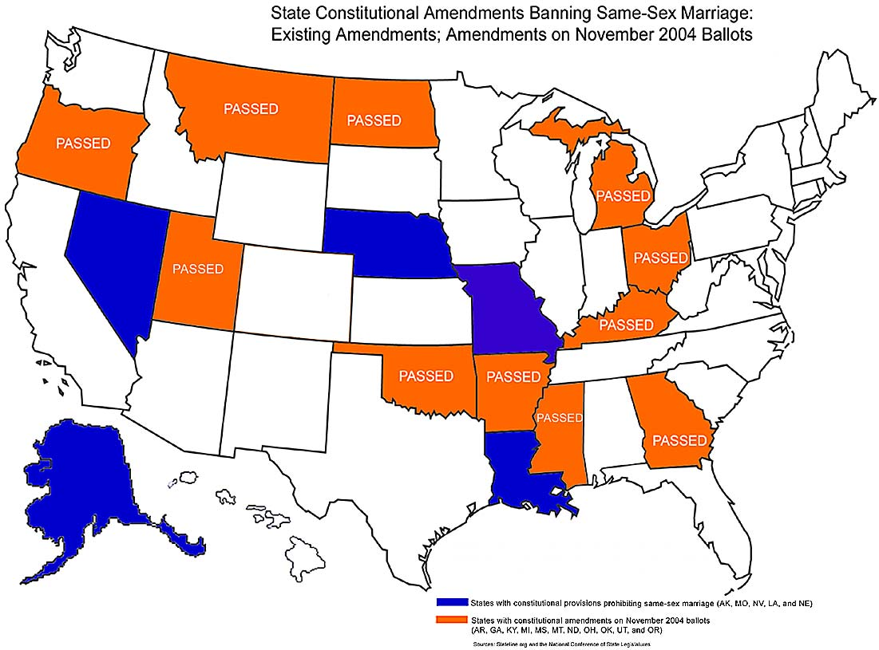

2004 – 11 states approve constitutional amendments to ban gay marriage
2006 – And Tango Makes Three first appears on the Top 10 Most Challenged Books list

Slide 45
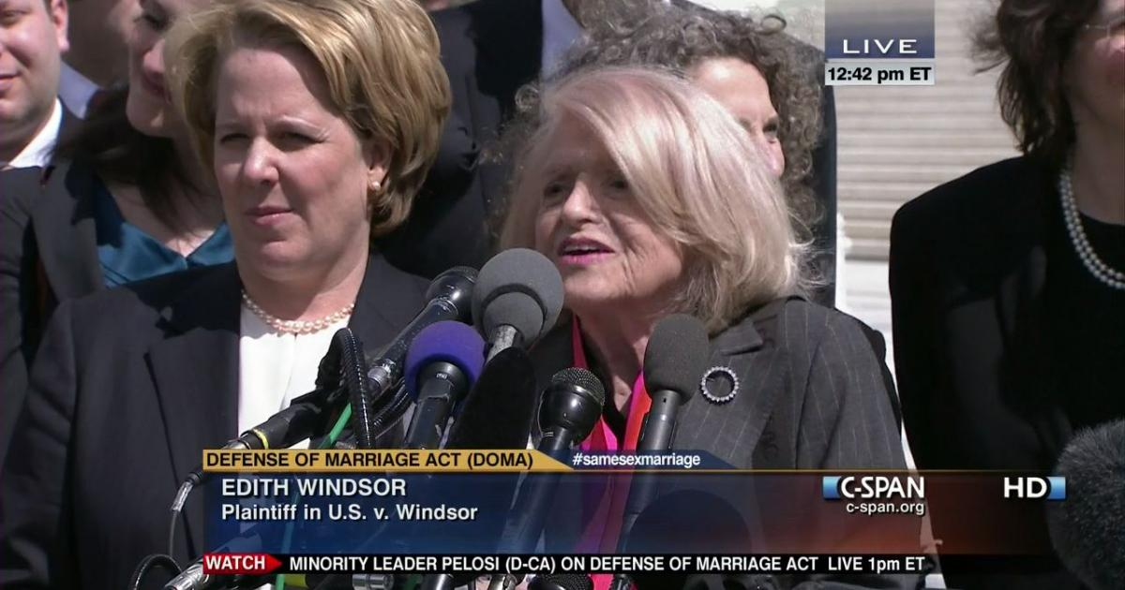
2013 – United States v. Windsor overturns the Defense of Marriage Act (DOMA)

Slide 46
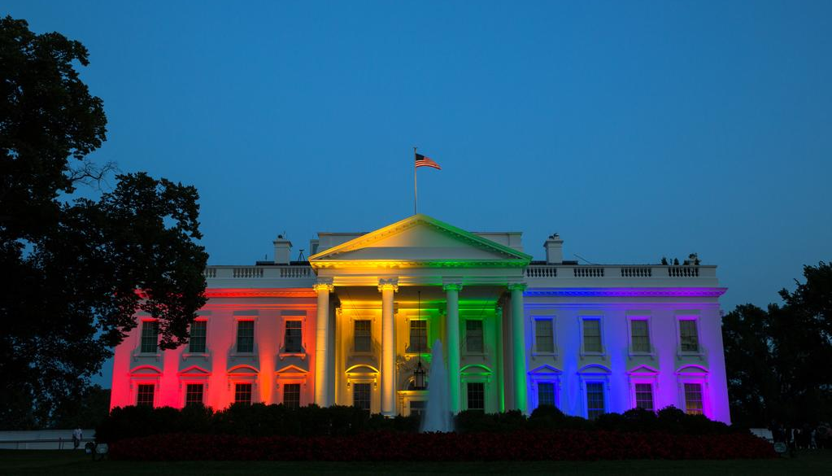
2015 – Obergefell v. Hodges provides constitutional right to marriage equality

Slide 47
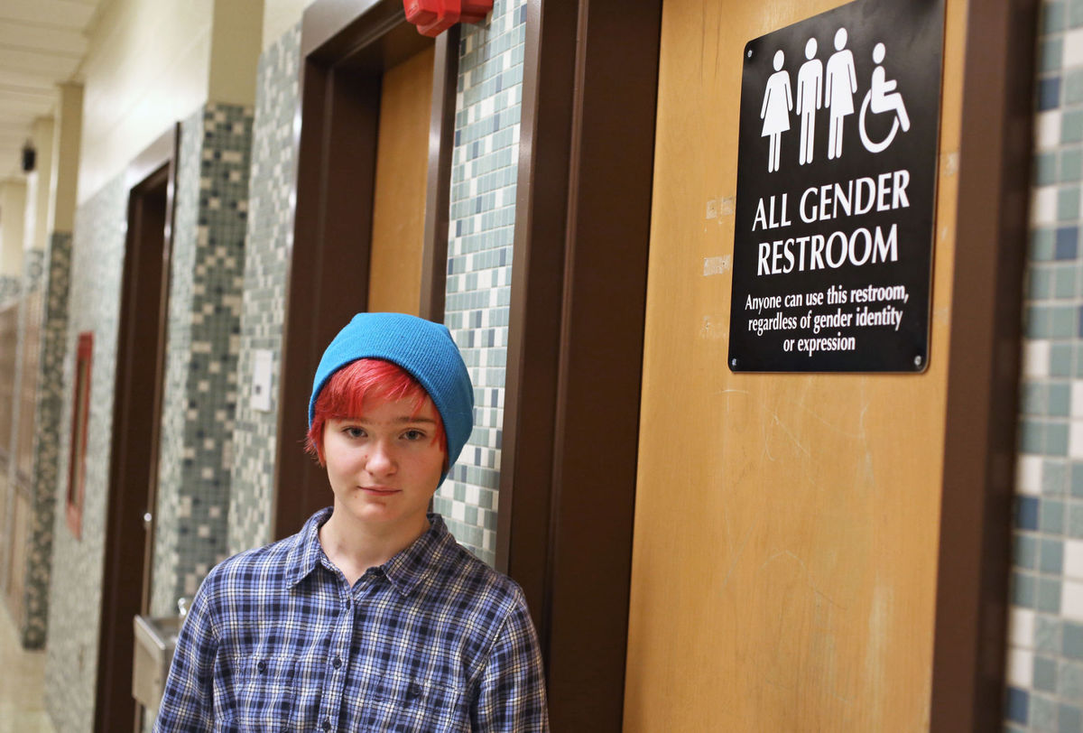
2015-2016 – “Bathroom bills” pop up in various states, intending to restrict restroom use by trans folks

Slide 48
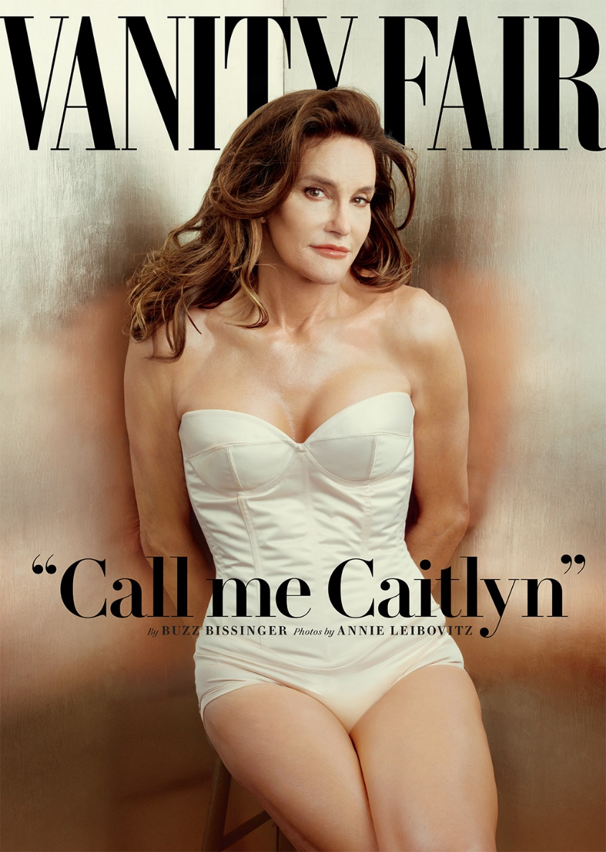
July 2015 – Caitlyn Jenner describes her life as a trans woman in a cover story in Vanity Fair

Slide 49


2015 – Two books about transgender youth make the Top 10 Most Challenged Books List

Slide 50
Survival

Slide 51
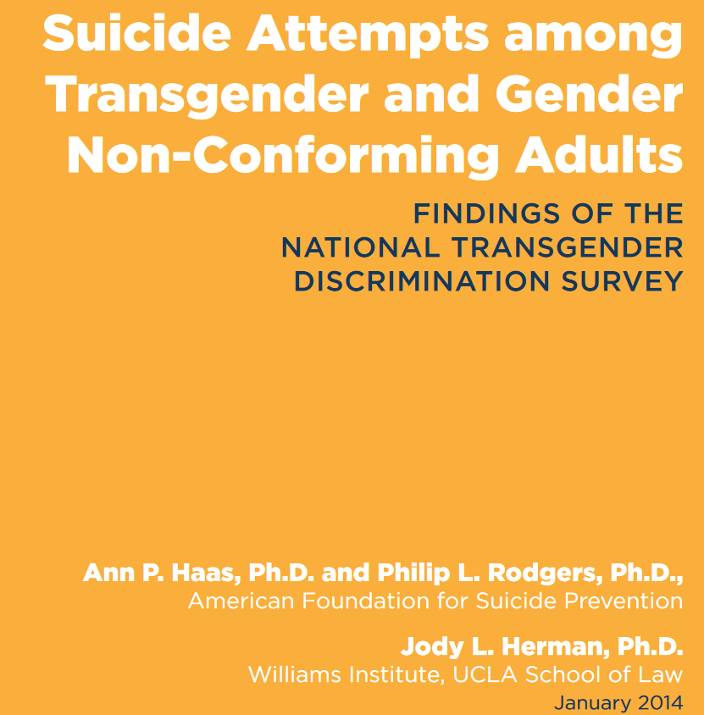

Slide 52
Percentage of adults who have attempted suicide

Slide 55
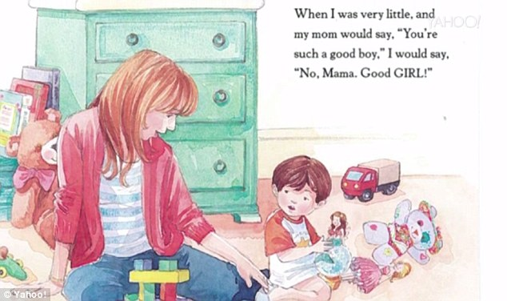

Slide 56
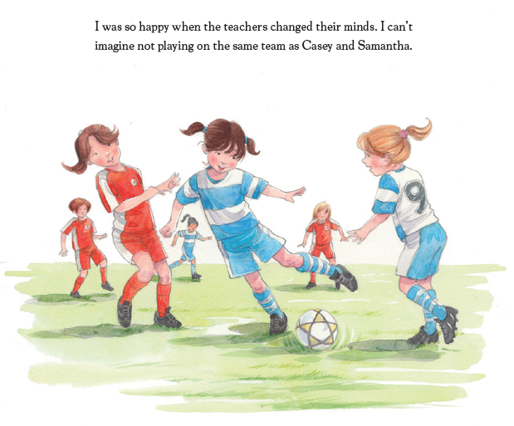

Slide 57
Unsuited for Age Group

Slide 58
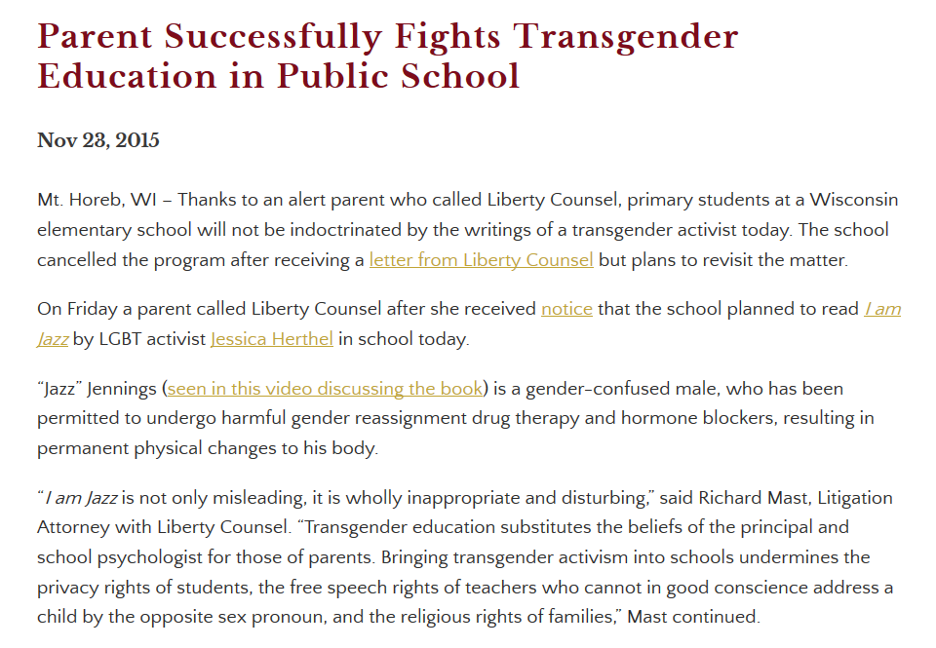

Slide 59


Slide 60
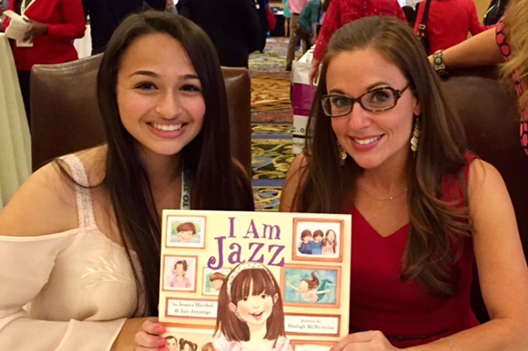

Slide 61


Slide 62
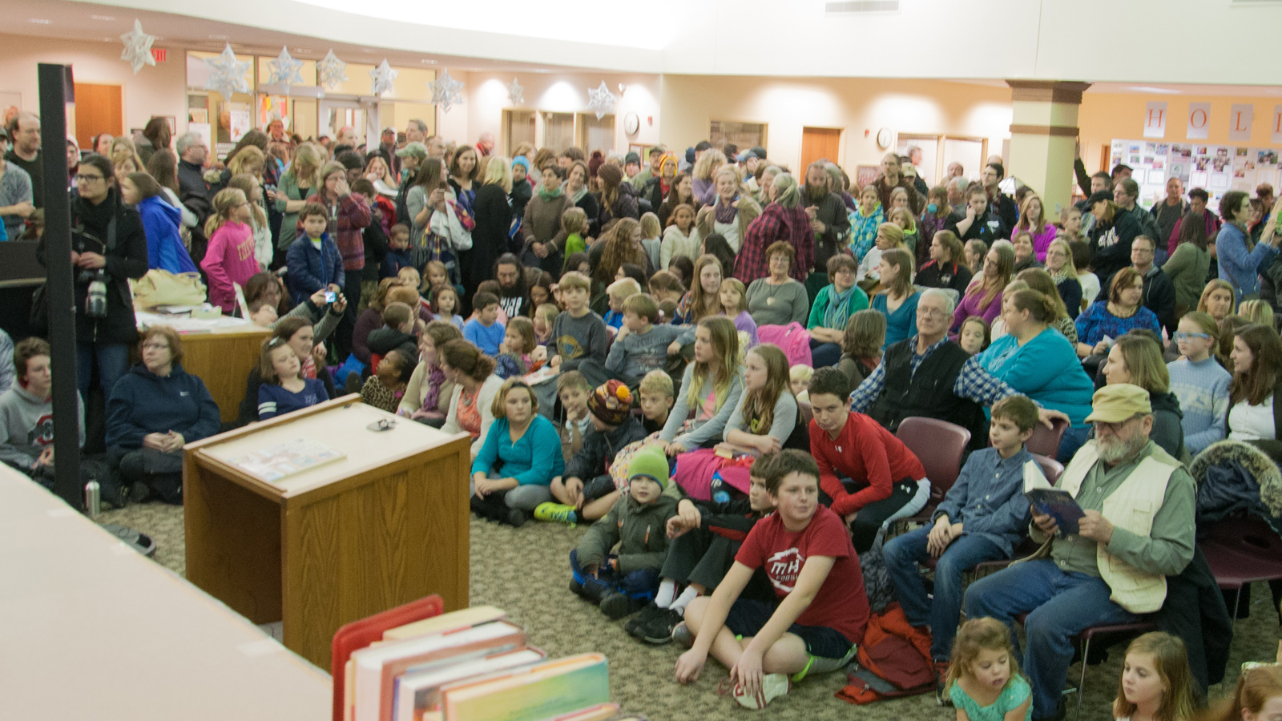

Slide 63

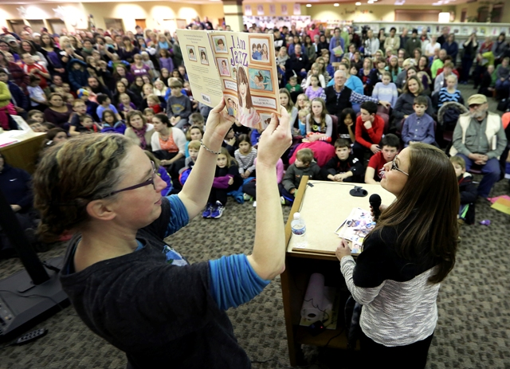

Slide 64
“The answer to hate speech is more speech; intellectual freedom will always find a way.” – Jessica Herthel, co-author of I Am Jazz

